Slide 1
5th Grade
Curriculum Night

Slide 2
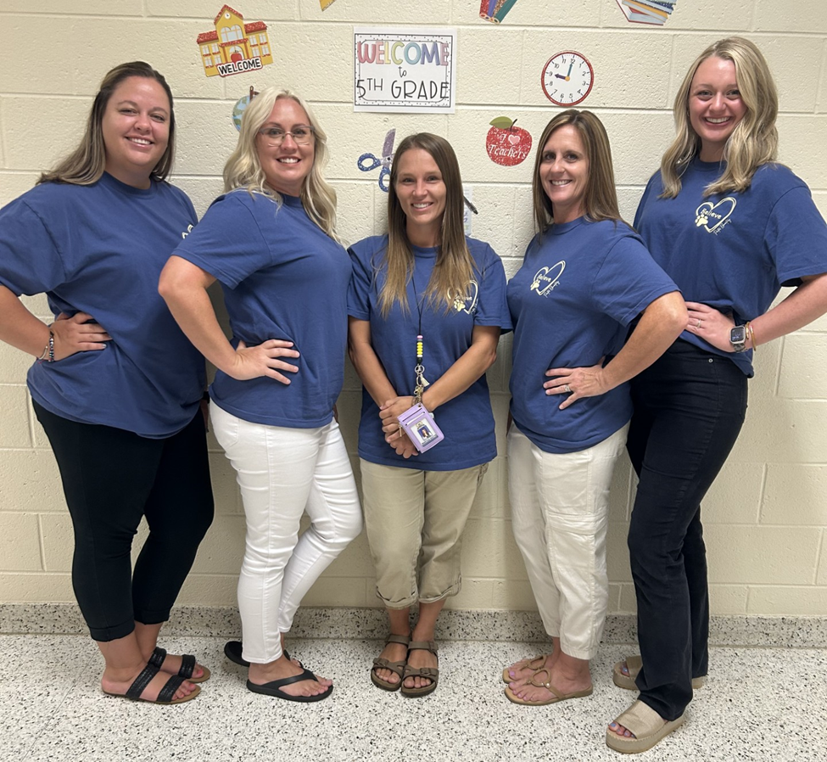
Teacher Introductions
Ms. Rutan
Mrs. Wright
Mrs. Watts
Mrs. Norman
Mrs. Freeman

Slide 3
Types of Assessments
Along with classroom assessments, your student will be taking the following assessments this year:
Beacon (Reading and Math)
Acadiance
Write Score
Georgia Milestones

Slide 4
Beacon
Reading
1 hour assessment to determine Lexile (reading) range
Taken 3 times per year
^{5th} grade Lexile band is 830 – 1010 by the end of the year

Slide 5
Beacon Performance Bands
200-390 Support Needed
391-551 Near Target
552-849 Prepared

Slide 6
Beacon Math Assessment
Math
Beacon Math is a computer-adaptive assessment that provides a direct measure of students’ readiness for math instruction
1 hour assessment
Taken 3 times per year

Slide 7
Beacon Performance Bands
200-434 Support Needed
435-585 Near Target
586-840 Prepared

Slide 8
Acadiance (Fluency)
All students take benchmark assessments three times during the school year (fall, winter, spring).
For benchmark assessments, students read three passages for one minute each. The median score of the three passages are taken.

Slide 9
Acadiance (Comprehension)
All students take benchmark assessments three times during the school year (fall, winter, spring).
For benchmark assessments, students read one passages for one minute each. The text has incomplete sentences. As they read, students circle the correct answer that fits with the text. The median score of the three passages are taken.

Slide 10
Write Score
Taken two times a year – over all three styles of writing: opinion and informational.
Information- October
Opinion- February
Students will read two passages. Students will answer three multiple choice questions, one short answer, and one extended written response.
Very similar to the writing assessment on Georgia Milestones

Slide 11
How are results used?
Student scores give information about if a student is on track for grade-level success
Identify common areas of need and provide extra help or purchase supplemental materials for specific skills
Teachers use results to prepare day-to-day reading lessons and small group instruction

Slide 12
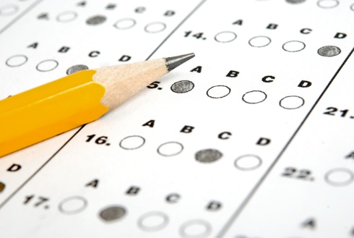
Georgia Milestones
^{-Reading (Two Days)}
^{-Math (One day)}
^{-Science}
**More information will be communicated to parents as the information is received

Slide 13
Georgia Standards www.georgiastandards.org

Slide 14
Shared Reading

Slide 15
Math
Whole group math is our daily time to teach new 5th grade math standards. We utilized ability groups during this time.
Groups Include: Teacher group, technology (practice fact fluency and review previous standards), and partner work.
We are using a new math program this year called Illustrative. This is all online and students are assigned warm-ups, lesson tasks, and cool-downs and complete them daily in whole group and small group.

Slide 16
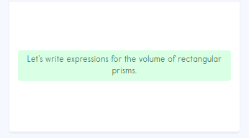
Math
10 minutes: whole group warm-up on ILC
15 minutes: Rotation 1 – teacher activities on ILC
15 minutes: Rotation 2 – independent practice
15 minutes: Rotation 3 – technology
5 minutes: Cool-Down/Exit-Ticket on ILC

Slide 17
Math Needs Based Instruction (NBI)
All 5th grade students participate in an NBI group providing interventions as well as enrichments.
This is a research-based program that meets students exactly where they are based on their needs determined by assessments.

Slide 18
Goal Setting
We are excited to watch ALL of our 5th graders GROW this year!
Students continue to set Reading and Math Goals this year as a way to encourage continued growth.
Students continually revisit and update their goals as needed throughout the year!

Slide 19
Conferences
October 7-8
March 10-11
**Students will release two hours early **

Slide 20
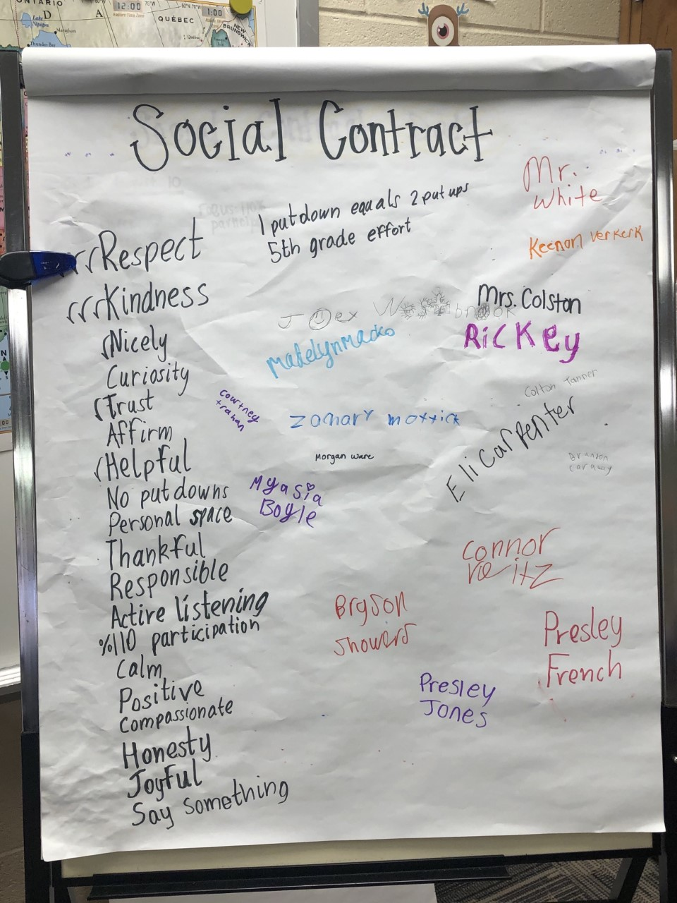
Classroom Expectations
Social Contract

Slide 21
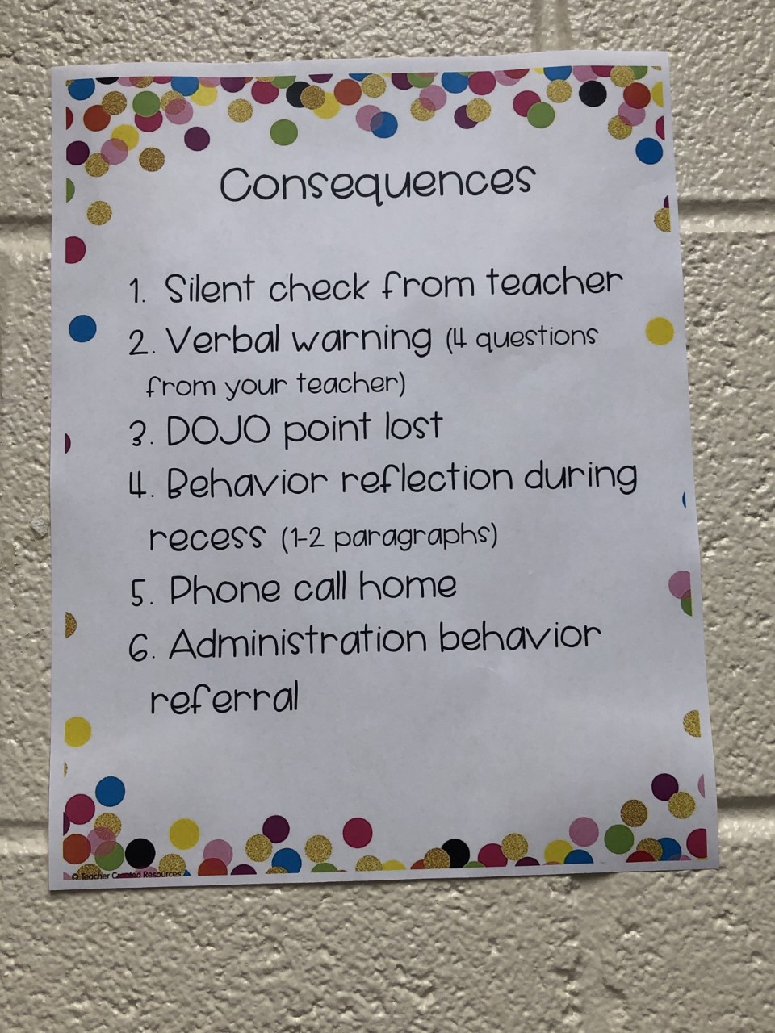
Classroom Expectations
Consequences

Slide 22
Four Questions
What are you doing?
What are you supposed to be doing?
Are you doing it?
What are you going to do about it?

Slide 23
Encouraging Reading at Home
Create a quiet reading area at home
Establish a routine for reading (at least 20 minutes each day)
Talk about books, magazines, etc.
Have your child read aloud to you
Visit ReadTheory.org
Read and ride – Play audiobooks while traveling so your child hears modeled fluent reading and ask questions about the story.

Slide 24
Encouraging Math at Home
Practice Math Fluency at home (flashcards, online sites, “quizzing” students, etc)
Check the newsletter to see what standards we are working on to supplement at home
Check out resources from the Parent Resource Center to support classroom learning

Slide 26
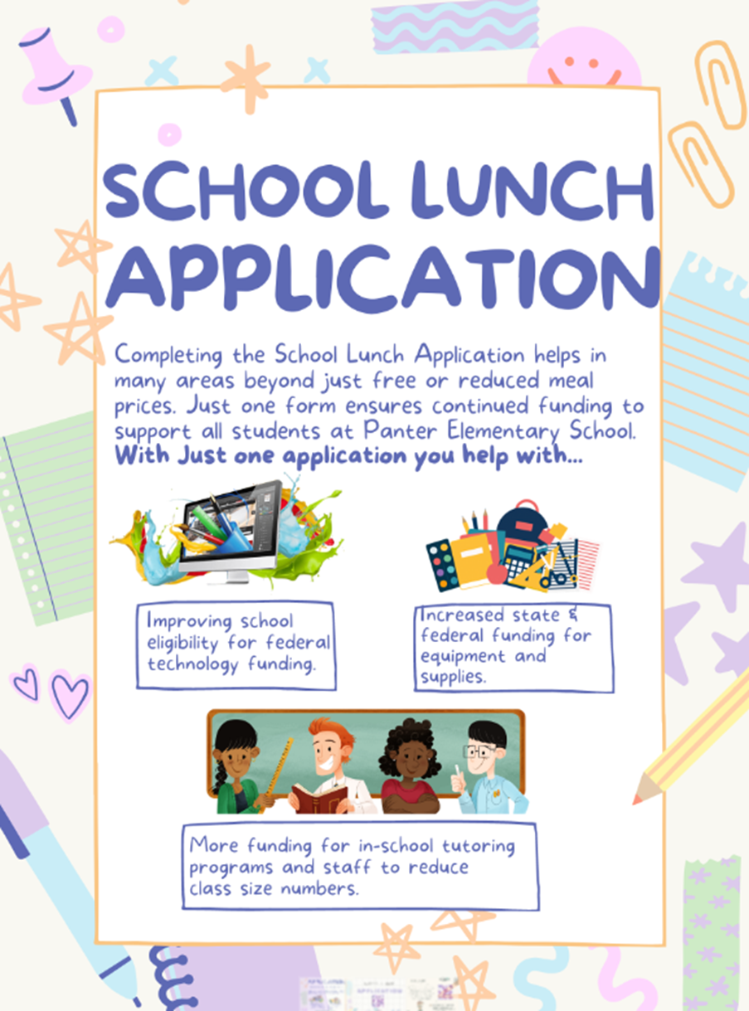
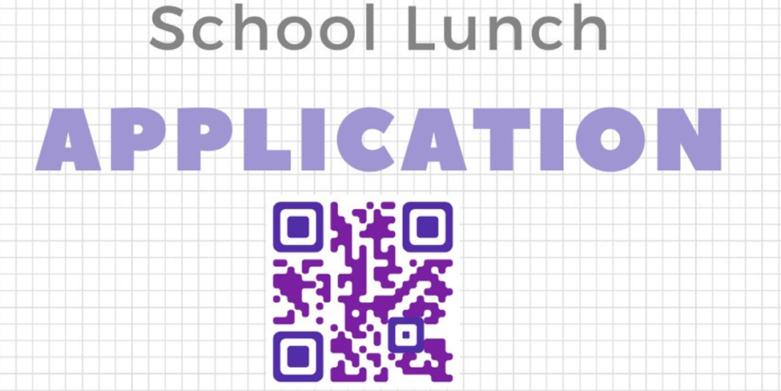

Slide 27
Questions?

