Slide 1
Sex Education
Coach Whitaker

Slide 2
Vocabulary
Sperm—the sex cell produced by the testes and is needed to fertilize an egg.
Ovum—the sex cell produced by the ovaries that are fertilized by a sperm.
Testis—the male reproduction organ that makes sperm and testosterone.
Penis—male reproductive organ that removes urine and delivers sperm.

Slide 3
Vocabulary
Semen—a fluid made up of sperm and other secretions from the male.
Ovary—organ that produces eggs and the hormones progesterone and estrogen.
Vagina—female reproductive organ that connects the uterus to the outside of the body.
Fallopian tube—the female reproduction organ that transport the egg from the ovary.

Slide 4
Vocabulary
Uterus—the female reproductive organ that provides a place to support a developing human.
Menstrual cycle—a monthly series of hormone controlled changes that prepare the uterus lining for a pregnancy.
Placenta—an organ that is produced during pregnancy to supply a baby with nutrients and oxygen.
Sexual intercourse—reproductive process in which the penis is inserted in the vagina and through which a human life may begin.

Slide 5
Vocabulary
Abstinence—the conscious decision not to participate in sexual activity and the skills to support that decision.
Sexually Transmitted Disease (STD)—an infectious disease that is spread by sexual contact.
Internal pressure—an impulse a person feels to engage in a behavior.
External pressure—pressure a person feels from another person or group to engage in a behavior.

Slide 6
Male Reproductive System
The male reproductive system works to produce sperm and deliver it to the female reproductive system.
Sperm are sex cells that are produced by the testes and are needed to fertilize an ________________________________.
Eggs or ova are sex cells produced by the female reproductive organs, called _____________________________________________.
Fertilization is the process by which a sperm and an egg and their genetic material join to create a new human life.

Slide 7
How the Male Reproductive System Works?
The testes (testicles) are the male reproductive organs that produce sperm and _________________________________________________.
Testosterone is the major male sex hormone. It regulates body changes during puberty and influences sperm production.
The scrotum is a sac containing the testes. Muscles in the scrotum move the testes closer to or further from the body to regulate _________________________________________________.

Slide 8
How the Male Reproductive System Works?
The penis is the male reproductive organ that removes urine from the body and can deliver sperm to the female reproductive system.
Urine or sperm passes through the penis in the _________________________________________________.
Sperm from the testes travel through the epididymis and the vas deferens. In the vas deferens, sperm mixed with fluids to make ____________________________________________.

Slide 9
Male Reproductive System

Slide 10
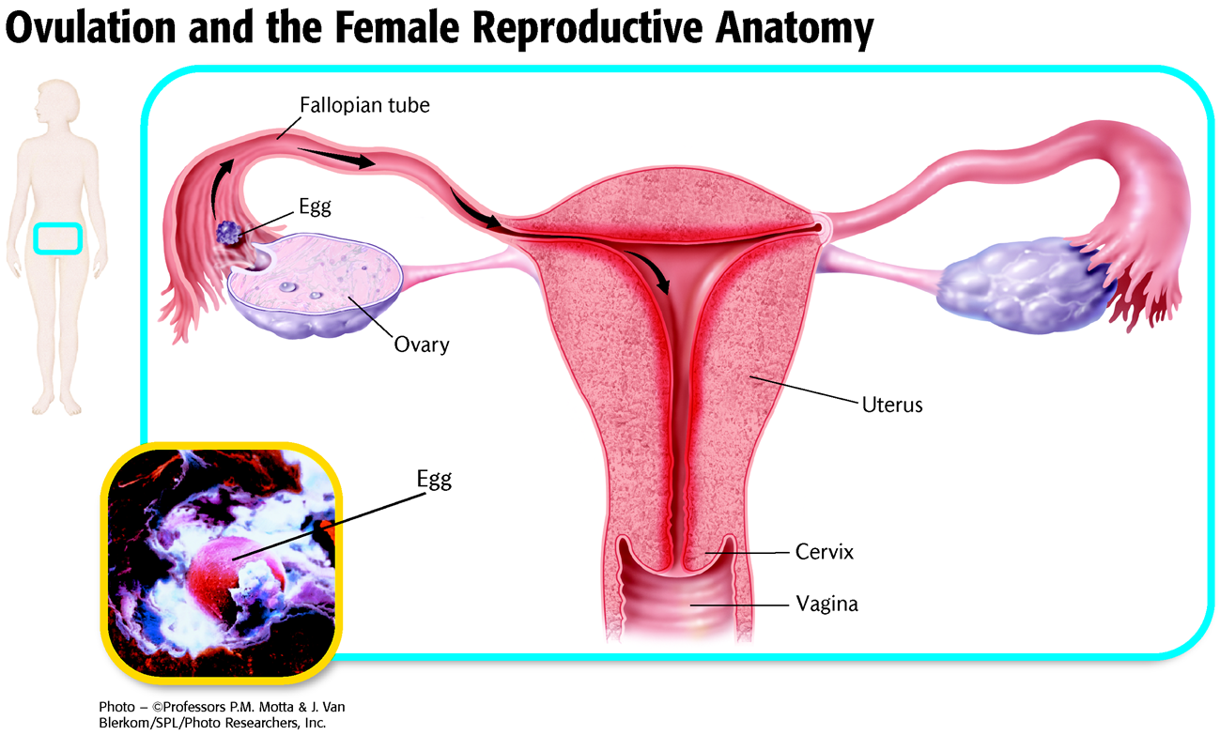
What the Female Reproductive System Does
The function of the female reproductive system is to produce eggs and to provide a place to support and nourish a developing ______________________________.

Slide 11
How the Female Reproductive System Works
Ovaries are the female reproductive organs that produce eggs and the hormones estrogen and progesterone.
A female is born with approximately 1 million to 2 million eggs.
Estrogen regulates body changes during __________________________________________.
Both estrogen and progesterone are involved in regulating monthly cycles and in the changes that take place in the body during ____________________________________________.

Slide 12
How the Female Reproductive System Works
The vagina is the female reproductive organ that connects the outside of the body to the uterus and receives sperm during reproduction. It is also part of the birth canal through which a baby is delivered.
The urethra carries urine out of the body from the bladder. It is above and separate from the vagina.
The uterus is the female reproductive organ that provides a place to support a developing ___________________________________________________.
Eggs travel from the ovaries to the uterus through the fallopian _________________________________________________.

Slide 13
How the Menstrual Cycle Works
Prior to ovulation (the release of an egg), the lining of the uterus thickens to prepare to support a growing human during ___________________________________________________________________.
Menstruation is the breakdown and discharge of the uterine lining out of the vagina. This occurs if a released egg is not fertilized. Menstruation lasts on average 3 to 7 days.
The average menstrual cycle lasts 28 days. Ovulation usually occurs on the 14th day. However, this length can ____________________________________________.

Slide 14
How Life Begins
Sexual intercourse is the reproductive process in which the penis is inserted into the vagina and through which a new human life may _____________________________________.
From the vagina, sperm travel through the uterus and into the fallopian tubes, where fertilization normally occurs.
After fertilization, the zygote travels to the uterus and embeds in the uterine wall.
The developing human in the first 8 weeks of development is called an __________________________________________.

Slide 15
How a Baby Develops
The placenta is an organ that develops in the uterus.
The placenta provide a developing baby with nutrients and removes ________________________________________.
The umbilical cord connects the embryo to the _______________________________________________.

Slide 16
How a Baby Develops
In the first trimester (first 3 months) the embryo grows rapidly.
By week 4, the heart starts beating, arm and leg buds appear, and the eyes and brain start to _________________________________________.
By the end of the first trimester, all the major body parts and organs have formed.
Beyond the first trimester, the developing baby is called a __________________________________________________.
In the second trimester, the organs continue to develop. By 4 months, the mother can feel the fetus move or kick.

Slide 17
How a Baby Develops
By the end of the second trimester, facial features are apparent, and you can tell if the fetus is male or female.
In the third trimester, the fetus gains most of its __________________________________________________.
At the end of 9 months, the baby is _________________________________________________.

Slide 18
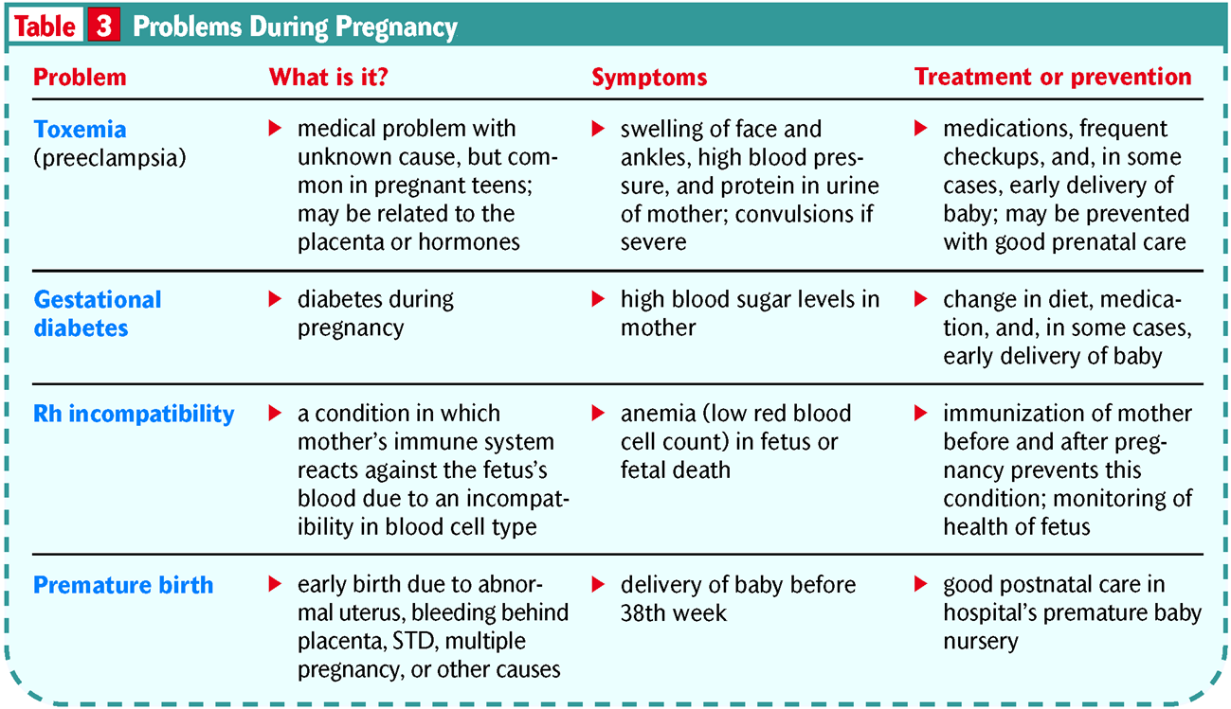
Problems During Pregnancy

Slide 19
Stages of Birth

Slide 20
Stages of Birth

Slide 21
What Is Abstinence?
Teen relationships should focus on emotional intimacy, not sexual ___________________________________________.
Abstinence is the conscious decision not to participate in sexual activity and the skills to support that decision.
A sexually transmitted disease (STD) is an infectious disease that is spread by sexual contact.
Avoiding the risk of STDs is just one of the many benefits of _____________________________________________.

Slide 22
Benefits of Abstinence

Slide 23
Pressures to Be Sexually Active
Internal pressure is an impulse a person feels to engage in a ________________________________________________.
External pressure is pressure a person feels from another person or from a group to engage in a ________________________________________________.

Slide 24
Setting Personal Limits
Setting personal limits can help you stay true to your commitment to be abstinent.
When setting personal limits, you can commit not only to being abstinent but also to avoiding situations that could lead to sexual __________________________________________________.
Tell your partner when you begin dating that you have made a commitment to remain sexually __________________________________.

Slide 25
Avoid Pressure Situations
Identify situations that could lead to sexual activity.
Avoid drinking alcohol or taking illegal _______________________________________________.
Look for dating partners who share your values about ______________________________________________.

Slide 26
Risks of Teen Sexual Activity
Possible consequences of teen sexual activity include:
loss of self-esteem
unplanned _____________________________________
sexually transmitted ________________________________________________
Abstinence is the only sure way to eliminate the risks of teen sexual activity.

Slide 27
Teen Pregnancy
1 in 10 female teenagers gets pregnant each year.
One out of three girls becomes pregnant at least once before reaching the age of 20.
Teen pregnancies are hard on the mother’s _________________________________________________.
Babies born to teen mothers are more likely to have health __________________________________________________.

Slide 28
Teen Pregnancy
Other reasons to avoid being a teen parent include:
You will have less time for ________________________________________________
Most teen mothers don’t marry the father.
Most pregnant teens do not finish high school.
Parents are legally responsible for their child’s well-being.
On average, teen fathers make less money than male teens who are not ______________________________________________.

Slide 29
Abstinence Eliminates the Risks of Teen Sexual Activity
There are many nonsexual ways to show __________________________________________________
1. Make your date feel special.
2. Find hobbies to do together.
3. Spend time with and get to know your date.
4. Show respect for your ___________________________________________________.

Slide 30
STDs: The Silent Epidemic
An epidemic is the occurrence of more cases of a disease than expected.
STDs are said to be a “silent epidemic” among teens and young ______________________________________________________.
Many STDs are asymptomatic, which means you can have the disease without any _____________________________________________________.
When there are no symptoms, a person may spread the disease without knowing it.
Sexually active people should undergo regular testing for STDs.

Slide 31
STDs and Teens
Behaviors that put teens at risk of STDs include:
1. being sexually ____________________________________
2. having more than one sexual partner
3. having a sexual partner who has had multiple sexual partners
4. using alcohol or __________________________________

Slide 32
How Are STDs Spread?
Ways that STDs are spread include:
any sexual activity that brings a person in contact with body fluids from an infected _____________________________________________
any sexual activity in which one person’s genitals contacts another person’s skin or mucous membranes
direct contact with open sores
a mother to her baby before or during birth, or during _________________________________________________

Slide 33
How Are STDs Spread?
Most STDs CANNOT be spread by the following:
_________________________________________________
Sharing eating utensils
Holding hands
Using public _________________________________________________

Slide 34
STDs Can Cause Permanent Damage
Some STDs, such as herpes, cannot be cured.
Some STDs can cause miscarriages or infant ________________________________________________.
Being informed about STDs can help you avoid them.
If you think you might have been exposed to an STD, see a doctor as soon as _________________________________________________

Slide 35
Common STD’s

Slide 36
Common STD’s

Slide 37
Common STD’s

Slide 38
Common STD’s

Slide 39
Common STD’s

Slide 40
Common STD’s

Slide 41
Common STD’s

Slide 42
Common STD’s

Slide 43
Common STD’s

