Slide 1
Annual Title I Parent Meeting
2024-2025 Hiram Elementary
200 Seaboard Ave.
Hiram, GA. 30141 Parent Resource Center conference room 10/24/24 8:00 a.m.
Engage. Inspire. Prepare.
All parents/guardians of students attending Hiram Elementary School have been invited to this meeting.

Slide 2
We welcome your questions and input throughout this presentation! We want to make sure you leave informed about the Title I program and know what opportunities we provide for families to be involved.

Slide 3
What Is a Title I School?
Title I was enacted in 1965 under the Elementary and Secondary Act amended by the Every Student Succeeds Act (ESSA). It is the largest Federal Assistance Program for our nation’s schools.
The purpose of Title I is to ensure that all children have a fair, equal, and significant opportunity to obtain a high-quality education and to achieve proficiency on high academic standards.​
Title I provides federal funds through the Georgia Department of Education to schools with at least 40% of the student population receiving free and reduced meals.

Slide 4
Title I funds at our school are applied to:
Supplementing programs that are already in place in schools, with the goal of providing all students with equal opportunity for achieving academic success
Hiring additional teachers and other support staff
Purchasing supplemental (additional) instructional materials, resources, and educational programs
Conducting parent activities and workshops focusing on how the school and families can work together to support students in content academic areas and other opportunities parents request
Providing professional development for teachers and staff
Establishing a parent resource center
Outreach to local Pre-K schools

Slide 5
How Hiram Elementary Participates in the Title I Program
Literacy: Bookworms-Shared, Interactive, DI, Writing, Bookworm Books
Math: Illustrative Math, Math NBI, Do The Math (DTM)
Parent Engagement
Provides supplemental services for instruction, professional learning, and parent engagement.

Slide 6
Our Schoolwide Requirements
Identifying school needs and areas requiring academic focus for improvement by reviewing student achievement data
Setting goals for improvement, and making plans to incorporate strategies that are based on scientific research to increase student achievement
Identifying students who will benefit from additional support
Partnering with families in order to provide the best support possible for all students to make progress
Providing staff with training, professional learning, resources and materials in order to enhance their teaching, and ability to work effectively with families
Sharing of School Improvement Plan

Slide 7
Hiram Elementary Schoolwide Program:
Our School Improvement Plan schoolwide goals include the following:
Students in grades 3, 4 and 5, scoring levels 3s and 4s on the Georgia Milestones Math Assessment will increase from 27.9% in May 2024 to 30.1% in May 2025.
Students in grades 3, 4, and 5 scoring levels 3s and 4s on the Georgia Milestones English Language Arts Assessment will increase from 34.3% in May 2024 to 44.3% in May 2025.
Reduce the number of office discipline referrals by 12% for the 2024-2025 school year.
The programs and supports in place to help us achieve these goals:
Title I staff
Professional Learning for teachers
Resources purchased with FY24 Title I Grant Funds
Parent and Family Engagement

Slide 8
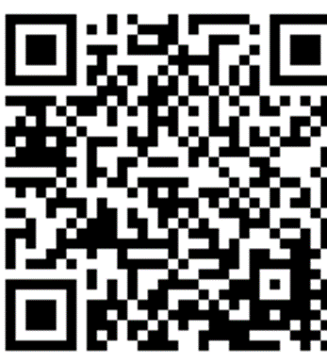
Curriculum Used at Hiram Elementary
Bookworms (ELA), Do the Math
Georgia Standards of Excellence
Academic standards are important because they provide an important first step in preparing our students for the future – a clear roadmap for learning for teachers, parents, and students. Having clearly defined goals helps families and teachers work together to ensure that students succeed. They also will help your child develop critical thinking skills that will prepare him or her for college and career.
Georgia Standards Website:
https://www.georgiastandards.org/

Slide 9
Tests and Assessments for Students in Elementary Grades
Tests and assessments include those provided by
the teacher, the county, and the state
Teacher - Projects, Reports, Unit/Chapter Tests,
Presentations
County – Acadience, Beacon ELA, Beacon Math
State - Georgia Milestones, ACCESS, GKIDS
Other assessments may apply. If applicable, our school will notify parents/guardians.

Slide 10
Tests and Assessments for Students in Elementary Grades
How do these assessments measure student progress?
Identifies areas in need of improvement, and to plan for instruction
Provides information for teachers and parents on areas where students have mastered learning and where they may need additional support
Provides information to plan for “next-steps” so that the student will experience continuous growth
What proficiency levels is my child expected to meet?
Teachers share specific information about student expectations/goals and assessment results during parent meetings, conferences and at the request of parents/guardians
Access previous test performance, standards, and attendance about my child using the Statewide Longitudinal Data System (SLDS) through the school’s parent portal (if applicable)

Slide 11
Georgia Milestones (Elementary)
Designed to measure how well students have learned the skills and knowledge described in the curriculum in the areas of English Language Arts and Mathematics in grades 3, 4, & 5
Science and Social Studies, grade 5
Taken at the end of the school year
Provides information on academic achievement at student, class, school, system, and state levels
Used to diagnose individual student strengths and weaknesses as related to the instruction of the state adopted curriculum, and to gauge the quality of education throughout Georgia.

Slide 12
2024-2025
Family Engagement Plans
PCSD Family Engagement Plan
Hiram Elementary Family Engagement Plan
Hiram Elementary Compacts

Slide 13
Teacher Professional Qualifications
Parent’s Right-to-Know
All parents have the right to request the following information about the professional qualifications of your student’s teacher(s):
Whether the teacher has met the Georgia Professional Standards Commission’s requirements for certification for the grade level and subject areas in which the teacher provides instruction;
Whether the teacher is teaching under an emergency or other provisional status through which Georgia qualifications or certification criteria have been waived;
Whether the student is provided services by paraprofessionals, and if so, their qualifications.

Slide 14
Parent & Family Engagement Opportunities
Open House: July 30, 2024
Parent-Teacher Conferences: October 7-8, 2024 & March 10-11, 2025
Prepping Your Child for State & Local Assessments – March 2025
Transitioning to the Next Level-May 2025
Provide feedback and input to assist with school level decision making
PTA meetings and events
Title I Family Nights
Assisting with school events

Slide 15
We love partnering with you!
We will promptly reply to your requests!
To contact school staff:
Call the school
Visit the Hiram Elementary website for teacher emails
Contact the school at 770-443-3392

Slide 16
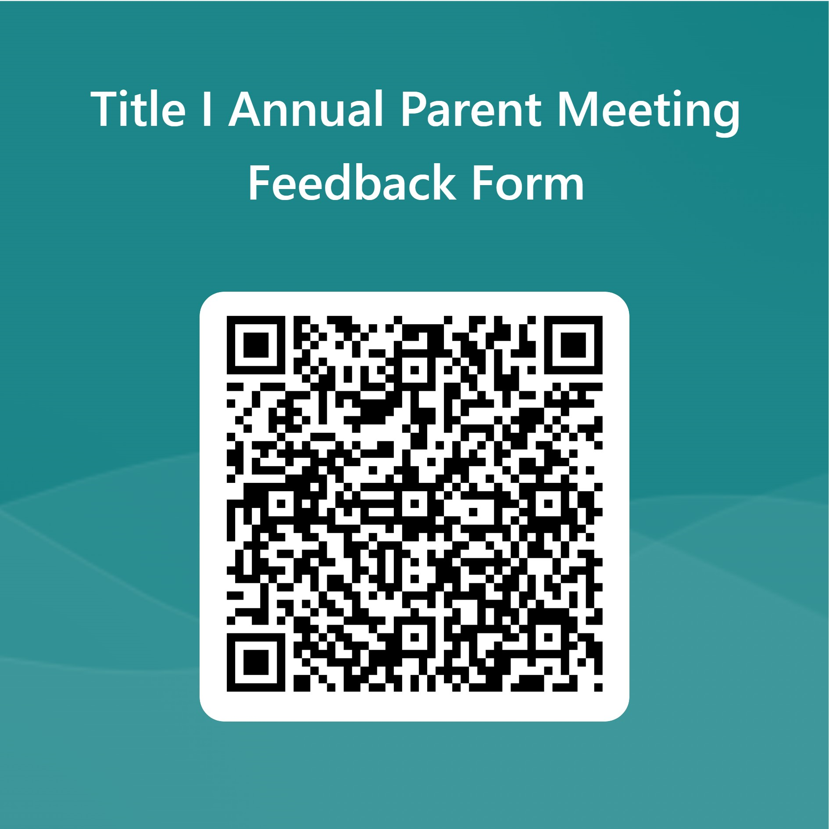
Thanks!
Closing and Feedback
Any questions?
Please click on the QR code
to fill out our
Feedback form.

