Slide 1
Precipitation is any type of water that forms in the Earth's atmosphere and then drops onto the surface of the Earth.

Slide 2
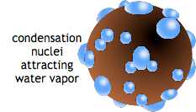
Water vapor, droplets of water suspended in the air, builds up in the Earth's atmosphere.
Water vapor in the atmosphere is visible as clouds and fog.
Water vapor collects with other materials, such as dust, in clouds. Precipitation condenses, or forms, around these tiny pieces of material, called cloud condensation nuclei (CCN).
Clouds eventually get too full of water vapor, and the precipitation turns into a liquid (rain) or a solid (snow).

Slide 3
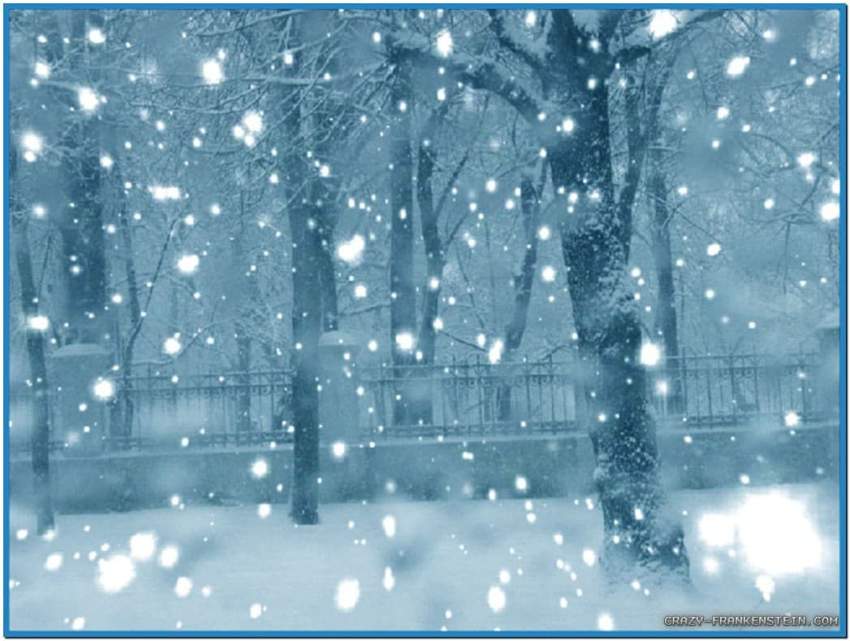
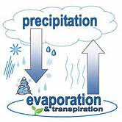
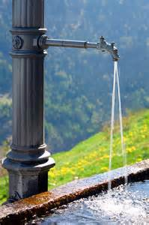
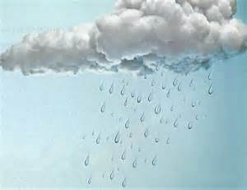
Precipitation is part of the water cycle.
It eventually evaporates and rises back into the atmosphere as a gas.
Precipitation falls to the ground as snow and rain.
In clouds, it turns back into liquid or solid water, and it falls to Earth again.
People rely on precipitation for fresh water to drink, bathe, and irrigate crops for food.

Slide 4
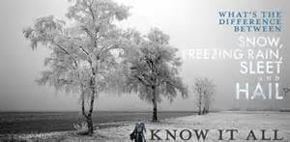
The most common types of precipitation are rain, hail, and snow.

Slide 5
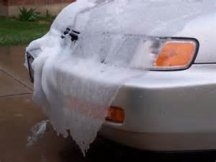
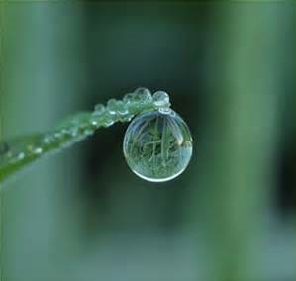
Rain is precipitation that falls to the surface of the Earth as water droplets.
Raindrops form around microscopic cloud condensation nuclei, such as a particle of dust or a molecule of pollution.
Even though cartoon pictures of raindrops look like tears, real raindrops are actually spherical.
Rain that falls from clouds but freezes before it reaches the ground is called sleet or ice pellets.

Slide 6
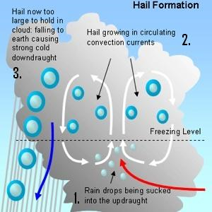
Hail forms in cold storm clouds.
It forms when very cold water droplets freeze, or turn solid, as soon as they touch things like dust or dirt.
The storm blows the hailstones into the upper part of the cloud. More frozen water droplets are added to the hailstone before it falls.
Unlike sleet, which is liquid when it forms and freezes as it falls to Earth, hail falls as a stone of solid ice.
Hailstones are usually the size of small rocks, but they can get as large as 15 centimeters (6 inches) across and weigh more than a pound.

Slide 7
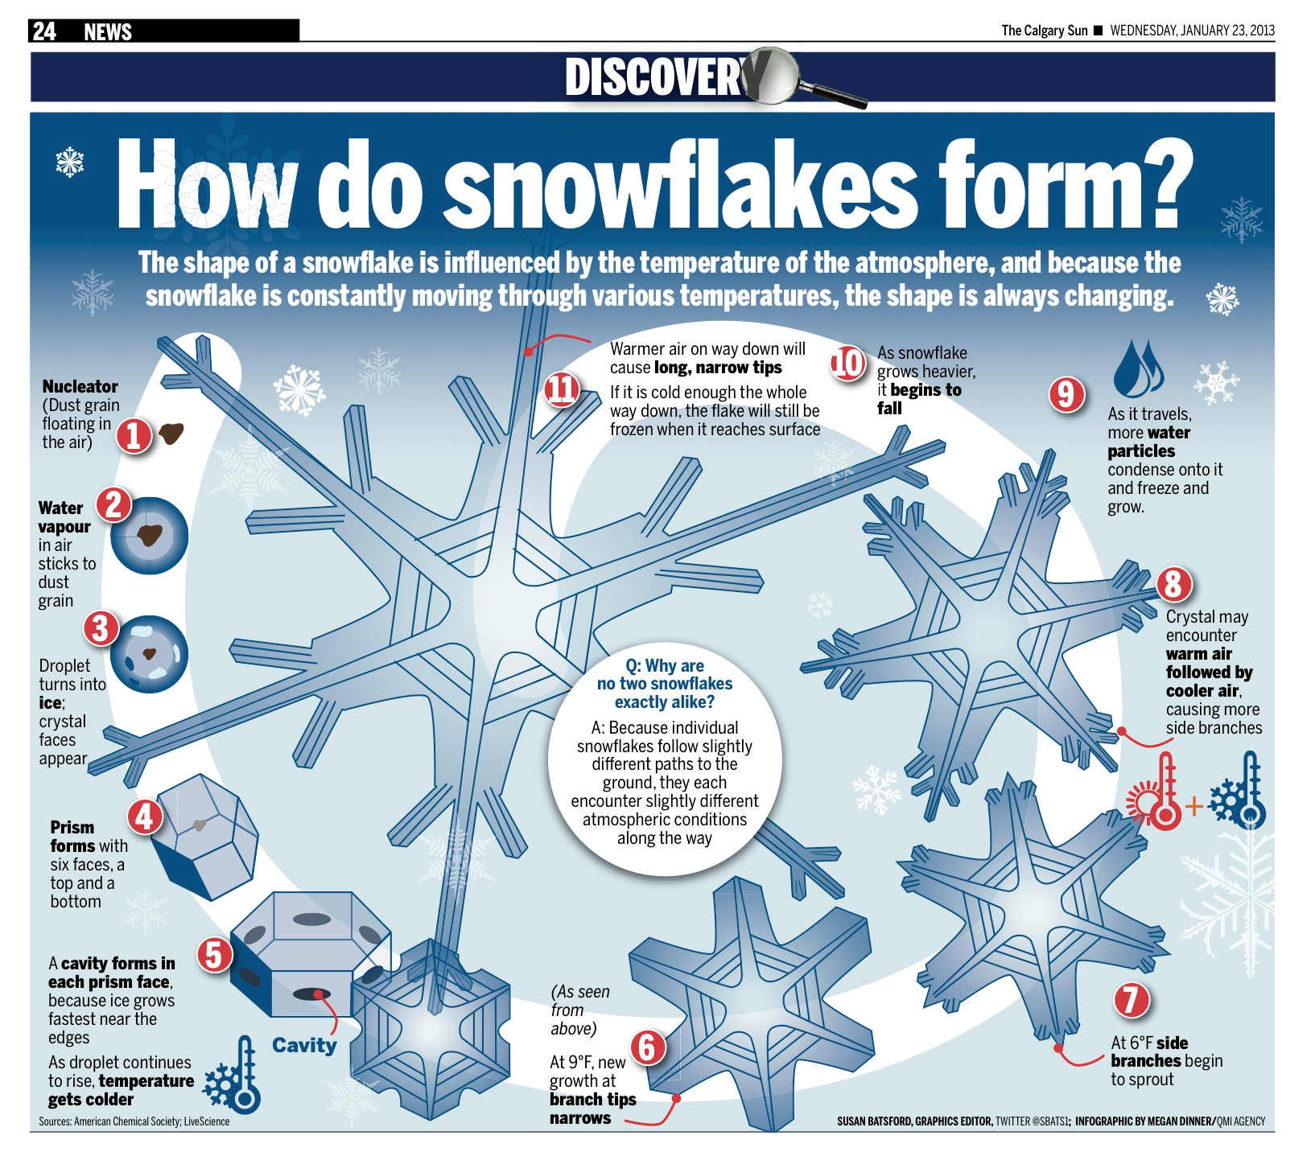
Snow is precipitation that falls in the form of ice crystals. Hail is also ice, but hailstones are just collections of frozen water droplets. Snow has a complex structure. The ice crystals are formed individually in clouds, but when they fall, they stick together in clusters of snowflakes.

Slide 8
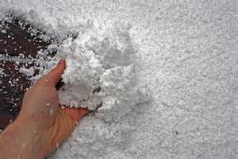
When snow falls in the form of a ball instead of soft flakes, it is called graupel. This happens when snow is melted and precipitation forms around the snow crystal.
Snow requires temperatures at the ground to be near or below freezing—less than 0 degrees Celsius (32-degrees Fahrenheit). Snow that falls on warmer ground melts on contact.

Slide 9
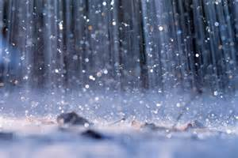
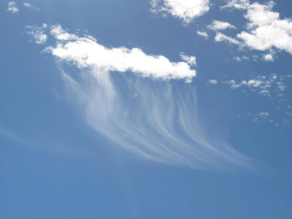
Sometimes, different types of precipitation fall at the same time. During harsh winter storms, for instance, it is not unusual for sleet and rain to fall at the same time.
Other times, precipitation doesn't fall at all. Virga is a type of precipitation that begins to fall from a cloud, but evaporates before it reaches the surface of the Earth.

Slide 10
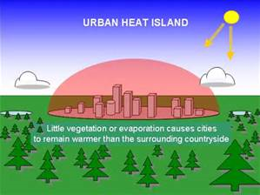
Human activity can create precipitation. Urban heat islands, which are areas around major cities that are much warmer than their surroundings, lead to increased and more intense rainfall near cities.

Slide 11
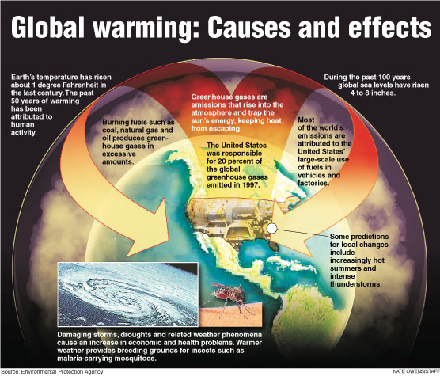
Global warming also causes changes in global precipitation. When the planet is hotter, more ice evaporates in the atmosphere. That eventually leads to more rainy precipitation. It usually means wetter weather in parts of North America, for example, and drier conditions in tropical areas that are usually humid.

