Slide 1
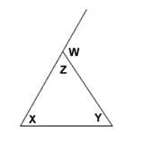
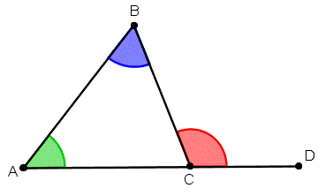
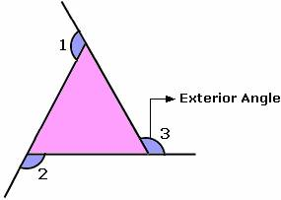
Interior Angles of Triangles
Learning Target
I CAN calculate the interior angles of a triangle.

Slide 2
Triangles Review Triangle Sum Theorem
Tear off the corners of your triangle. Glue the center piece in place in your book.

Slide 3
Triangles Review Triangle Sum Theorem
Line up the edges and glue them in.

Slide 4
Triangles Review Triangle Sum Theorem
What have you created?

Slide 5
Triangles Review Triangle Sum Theorem
A straight line!

Slide 6
Triangles Review Triangle Sum Theorem
180 degrees!
Measure the line to determine the degrees.

Slide 7
NOTE:

Slide 8
Practice: pg 355 Your Turn

Slide 9
Exterior Angles of Triangles
Learning Target
I CAN calculate the exterior angles of a triangle.

Slide 10
Discovery Activity – Remote Exterior Angles

Slide 11
Triangles Review Triangle Sum Theorem
Trace your triangle into your notebook.

Slide 12
Remote Exterior Angles
Extend a line from one edge.

Slide 13
Remote Exterior Angles
I
2
3
Tear off two corners of your triangle. Glue the remaining piece in place in your book.

Slide 14
Remote Exterior Angles
1
I
2
I
3
2
Glue those two pieces in place in your book.

Slide 15
NOTE: Relationship Between Exterior and Remote Interior Angles in a Triangle

Slide 16
Relationship Between Exterior and Remote Interior Angles in a Triangle

Slide 17
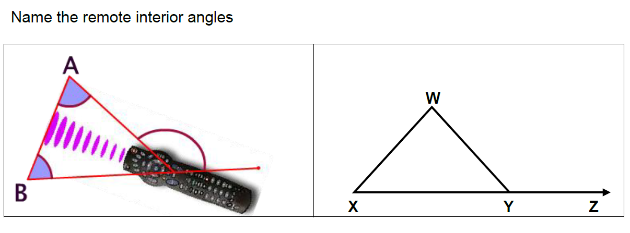
Relationship Between Exterior and Remote Interior Angles in a Triangle

Slide 18
Summary
The measure of an exterior angle of a triangle is equal to the sum of the measures of both remote interior angles.
The sum of the exterior angles of a triangle is 360°.

Slide 19
NOTE: Solve for x
120º = x + (x+20º)
120º = 2x + 20º
-20 -20
100 = 2x
2 2
50 = x

Slide 20
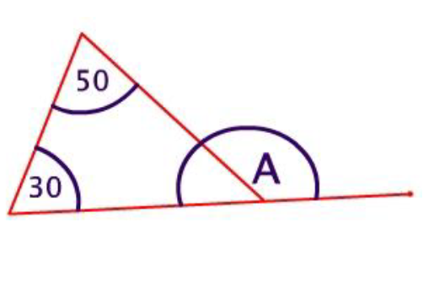
Boards: Solve for A
50º + 30º
A = 80º

Slide 21
Boards: Solve for y
60º + 40º
y = 100º

Slide 22
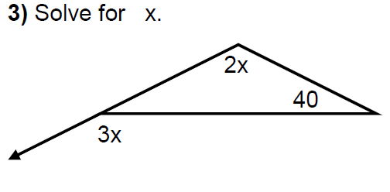
Boards: Solve for x
3x =2x + 40º
x = 40º

Slide 23
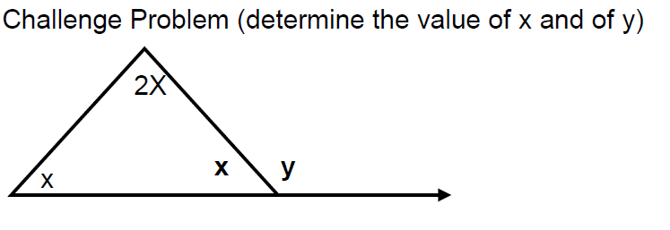
NOTE: What strategy would you begin with?

Slide 24
Practice: pg 357 Your Turn
What strategy will you start with?

Slide 26
(5y+3)+(4y+8) = 146
9y+11 = 146
-11 -11
9y = 135
9 9
y = 15
Solve 5(15)+3 = M
78 = M

Slide 27
Practice: pg 357 Your Turn

Slide 28
Learning Target
I CAN calculate the exterior angles of a triangle.
Complete pg 358 1-13
Closing ticket
HW - Complete the Exterior Angles Discovery

