Slide 1
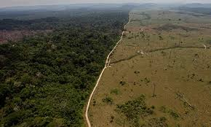
Deforestation in the Amazon Rainforest
Largest Environmental Concern
Deforestation in Brazil’s Amazon area
Deforestation is the permanent destruction of forests in order to make the land available for other uses.
Extraction of natural resources
Humans are removing trees for livestock (ranching), logging, rubber tapping, and agriculture (= $$)

Slide 2
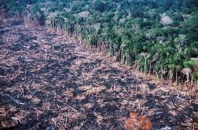
Deforestation of the Amazon Rainforest
Causes
Money!!
Brazilians cut down trees to use land
Some are sold, but most are not (= burned!)
Land is then used for cattle ranching, agriculture, and logging industries

Slide 3
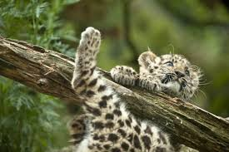
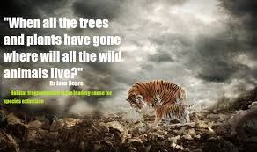
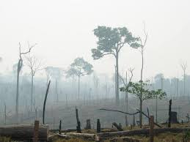
Deforestation of the Amazon Rainforest
Effects
Less world oxygen
Global warming
Loss of homes/ habitats
Extinct plants and animals

Slide 4
Deforestation of the Amazon Rainforest
Solutions
Government laws of where and how much land can be taken (QUOTAS)***
Other jobs and skill training to give natives other job options
Global information and awareness campaigns

Slide 5
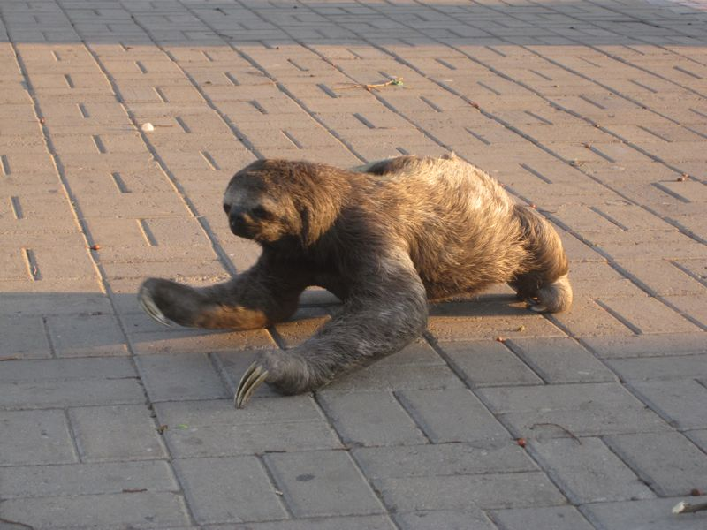
Deforestation of the Amazon Rainforest
Real-Life Situations:
Pollution levels are rising due to so much burning… = lowered health of citizens
Animals (like sloths) are being found in cities because their homes have been taken.
These wild animals do not know how to interact with humans (and vise versa) and this causes violence/ injury when either feels threatened.

