Slide 1
Energy Flow In Ecosystems
Guided Reading WB pgs. 285-287, and 291-292

Slide 2
True or False?
Each organism has a role in the movement of energy through its ecosystem?
True!
Although each organisms role is different, all parts of the ecosystem are necessary for the ecosystem to work!

Slide 3
Energy Roles in an Ecosystem
An organism’s energy role is determined by how it obtains energy and how it interacts with other organisms within the ecosystem.
The energy roles within an ecosystem are producer, consumer, and decomposer.

Slide 4
Producers
Organisms that make their own food by using the sun’s energy to turn water and carbon dioxide into food through a process called photosynthesis.
Producers are the sources of all the food in an ecosystem!
Examples of Producers: Plants, algae, and some bacteria

Slide 5
True or False?
Energy enters all ecosystems as sunlight?
False!
Energy enters most ecosystems as sunlight, but the rest enters the ecosystem through producers!

Slide 6
True or False?
Producers are the source of all the food in an ecosystem?
True!

Slide 7
Consumer
An organism that obtains energy by feeding on other organisms.

Slide 8
Types of Consumers
Type of Consumer | Type of Food
Herbivore | Only plants
Carnivore | Only animals
Omnivore | Both plants and animals
Scavenger | Dead organisms

Slide 9
Decomposer
Organisms that breaks down waste and dead organisms.
The two major groups of decomposers are bacteria and fungi.

Slide 10
True or False?
Decomposers return raw materials to the environment.
True!

Slide 11
Food Chains and Food Webs
A series of events in which one organism eats another and obtains raw energy is called a food chain.
The many overlapping food chains in an ecosystem make up a food web.

Slide 12
Energy Pyramids
As you move up the energy pyramid, each level has less energy available than the level below.

Slide 13
Energy Pyramids
Show…
The amount of energy that moves from one feeding level to another in a food web.

Slide 14
Food Webs
Producers form the base of the food web.
First-level consumers feed on the producers, and the movement of energy is from the producers to the first-level consumers.
Second-level consumers feed on the first-level consumers, and the movement of energy is from the first-level to the second-level consumers; they may be carnivores or omnivores.
Note: An organism may play more than one role in a food web.

Slide 15
Food web example:
Grass is a __________________.
A mouse is a ____________________ consumer.
A kestrel is a ___________________ consumer.
If the kestrel died, and a buzzard was eating the kestrel, then the buzzard would be a _____________________.

Slide 16
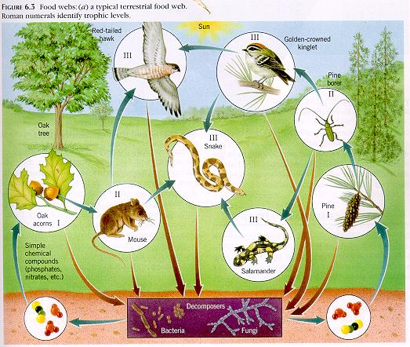
True or False?
Most food webs only have three or four feeding levels.
True!

Slide 17
Why are there usually few organisms at the top of a food web?
…because there is a limited amount of energy available at that level of a food web.

Slide 18
Biogeography
The study of where organisms live is called biogeography.
Note: In addition to studying where species live, biogeographers also try to understand what led to the worldwide distribution of species that exist today.

Slide 19
Continental Drift
One factor that has affected how species are distributed is the motion of Earth’s continents.
Continental Drift is…
The very slow movement of the continents on a layer of solid rock called plates.

Slide 20
True or False?
All of today’s continents were part of one large land mass about 225 million years ago.
True!

Slide 21
What do you think?
The movement of the continents has had little impact on the distribution of species.
No!
Consider Australia for example, Australia drifted away from the other landmasses. Organisms from other parts of the world could not reach the isolated island. Kangaroos, koalas, and other unique species flourished in this isolation.

Slide 22
Dispersal
The movement of organisms from one place to another is called dispersal.
Dispersal
can be caused by
Wind
Water
Living Things

Slide 23
Wind and Water
Wind can disperse seeds, the spores of fungi, tiny spiders, and other small, lightweight organisms.
Water can disperse things that float such as coconuts and leaves.

Slide 24
Other living things
Some organisms may be dispersed by other living things.
For example:
A bird may eat seeds and deposit them in its waste in another location.
A duck may carry algae or fish eggs on its feet from pond to pond.
A dog may carry sticky plant seeds on its fur.

Slide 25
True or False?
Humans are not important to the dispersal of other species.
False!
As people move around the world, they take organisms with them. Sometimes it is intentional and other times unintentional.

Slide 26
Exotic Species
Species that have been carried into a new locale by people are called exotic species.
Example: Kudzu is not a native species to Georgia, but was brought here from China to help control erosion; however, it covers other living things blocking them from the sunlight and water, eventually killing the organism.

Slide 27
Limits to Dispersal
Three factors that limit dispersal of a species are physical barriers, competition, and climate.

Slide 28
Physical Barriers
Physical barriers limit the movement of organisms.
Examples of these barriers are water, mountains, and deserts.

Slide 29
Competition
When an organism enters a new area, it must compete for resources with the species already there.
So, how can competition act as a barrier to dispersal?
If species already in the area are thriving, they may outcompete a new species and act as a barrier to its dispersal.

Slide 30
Climate
The typical weather pattern in an area over a long period of time is the area’s climate.
Climate can limit dispersal.
For example: Conditions at the top of the mountain are different than those at the bottom. Shrubs and cactus can not grow at the top in the freezing cold weather.

Slide 31
Climate
Places with similar climates tend to have species that occupy similar niches.
For example: Most continents have a large area of flat, grassy plains. So these continents have organisms that occupy the niche of “large, grazing animals”.

Slide 32
Populations
A population is all of the members of one species in a particular area.
A species is a group of organisms that are physically similar and can mate with each other and produce fertile offspring that can also mate and reproduce.

Slide 33
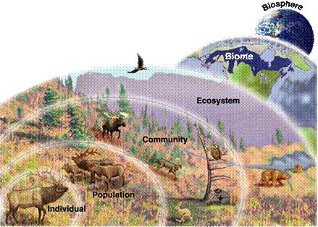
The 4 Levels of Ecological Organization
Species
Population
Community
Ecosystem
(Biome)
(Biosphere)
Species

Slide 34
Determining Population Sizes
Look at the jar of beans. Your goal is to determine the bean population size, but you do not have time to count every bean. You may use any of the following to help you: a ruler, beaker, another large jar. Set a timer for two minutes when you are ready to begin.
After two minutes, record your answer. Then count the beans. How close was your answer?

Slide 35
4 Methods for Determining Population Sizes
Direct Observation – This is the most obvious way, and involves counting each member of the population. Ex: Counting all of the crabs in a tide pool.
Indirect Observation – This involves observing the signs of organisms rather than the organisms themselves. Ex: Counting the number of swallow nests, and assuming that there are 4 swallows/nest (2 parents, 2 offspring), you can estimate the total population size.

Slide 36
4 Methods for Determining Population Sizes
Sampling – This method is used when the population is too large to count individual members. Instead ecologists use estimation, based upon reasonable assumptions. Ex: Count all of the organisms in a small area then multiply to find the number for the larger area.
Mark-and-Recapture Studies – This involves capturing members of the population, marking them, releasing them, and then after a determined amount of time, try to recapture the same species of organisms. Repeating several times, allows ecologists to collect population data, and when plugged into a mathematical formula, provides an estimation of the total population.

Slide 37
Changes in Population Size
Populations can change when new members join the population or when members leave the population.

Slide 38
Changes in Population Size
Births and Deaths
Birth rate – The main way in which new individuals join a population. The birth rate of a population is the number of births in a population in a certain amount of time.
Death rate – The main way individuals leave a population. The death rate of a population is the number of deaths in a population in a certain amount of time.
Population Statement:
If birth rate > death rate, population size increases
If death rate > birth rate, population size decreases

Slide 39
Changes in Population Size
Immigration – The coming, or moving into a population.
Emigration – The leaving, or moving out of a population.

Slide 40
Population Density
The number of individuals in an area of a specific size.
Calculating Population Density:
Population Density = (# of Individuals/Unit Area)
What is the population density of the flamingos in the pond on the top right?

Slide 41
Limiting Factors
Limiting factors are anything that restricts the number of individuals living in a population such as
Carrying capacity
Changes in the distribution of species
Environmental issues
Examples of limiting factors are:
Food
Water
Space
Weather conditions

Slide 42
Environmental Issues
Three Main Issues
Resource Use
Population Growth
Pollution
How do these factors act as a limiting factors to populations?

Slide 43
Carrying Capacity
A
P
How

Slide 44
Carrying capacity
Carrying capacity is the largest population that an area can support. If there aren’t enough biotic or abiotic factors the species are not able to survive in the ecosystem and changes occur

Slide 45
Results of Changes to Ecosystems
Threatened Species – species that could become endangered in the near future
Endangered species – species in danger of becoming extinct in the near future
Extinction – the disappearance of all members of a species from Earth

