Slide 1

Welcome to
Parent Night
2024-2025

Slide 2
Our Day
7:30 – 7:55 Morning Work/Restroom
7:55 Announcements Begin
Reading DI
Math NBI/Math Lesson
Specials
Heggerty/Sounds Wall
Lunch
Handwriting
Shared Reading
ELA/Writing
Recess
Dismissal 2:15

Slide 3

Behavior
In our class we have the 5 simple rules:
1.Follow directions quickly
2. Always do your best
3. Be Kind to Others
4. Be a good listener
5. Keep our room safe

Slide 4
Moving Clips
Students move their clips when given more than one chance to correct their behaviors. Students in some classes may earn Dojo points.
Students can earn their clip back if they have made better choices and corrected their misbehavior.
Yellow- Warning
Orange- Consequence
Red- Consequence/Parent Contact

Slide 5
PBIS
(Positive Behavior Interventions and support)
The goal is to recognize everyone for making great choices throughout the day and allow them to be rewarded and praised for those choices.
Throughout the day there will be many opportunities to be “recognized” for positive behavior. This can include (but is not limited to) picking up trash in your area without being asked. Sitting down and beginning your work without being prompted. Helping a friend in need. Walking down the hall staying on the “trail” and holding your “bubble”.
Student will earn FISH for being caught doing good and can be entered for a chance to earn "P" with the principal as a reward.

Slide 6
Folder/ Notebook
It must come to and from school with your child everyday.
Please sign the behavior sheets nightly.
Please check for important documents and/or reminders daily.
Money needs to be in zipper pouches and NOT in a book bag or lunch box. Please label the money for whatever it is meant to be used for.
Wednesday Folders: They will come home each week with all the work and any important papers. Please review them and return them Thursday morning.

Slide 7
Handwriting
In kindergarten we teach proper letter formation/handwriting. Students are expected to properly write all of the upper- and lower-case letters by the end of the year.
We will use a variety of text for letter recognition.

Slide 8
Snack
Please be sure to provide a hearty, healthy snack for your child(no candy or drinks other than water).
We eat snack in the morning so that the students can wait for lunch at noon.
Examples of good snacks:
Goldfish, crackers, fruit, graham crackers, etc.
Please remember we cannot eat foods that require spoons or refrigeration.

Slide 9

Tasty Treat and Hat Money
Students can purchase ice cream treats on Thursdays if they have a pass. You can buy a pass on RevTrak.
Students can purchase extras through the lunch line including chips, cookies, and snacks) If you wish to limit what they can buy, you will need to provide a written note.
Please place the money in the zipper pouch in the front of the notebook and label it Tasty Treat.
Please do not place money in their pockets, lunch boxes, or bookbags. We will not look there for the money, and they might miss out.
Your child can wear a hat for a 50-cent donation to Relay for Life on Fridays only.

Slide 10
Transportation
The way that your child goes home is of utmost importance.
While it is important that your child is aware of their transportation and can tell me how they are supposed to go home, I cannot just take their word on how they go home or any transportation change.
Communicate in a written note if your child will go home differently than what they normally do. Please sign and date the note so that we know you sent it. We CANNOT accept tranportation changes on Remind, e-mail, or Dojo.
No changes can be made after 2pm

Slide 11
Newsletter
We send a weekly newsletter on Friday for the following week that reviews the information your child will learn over the week.
It will also tell the color of the week and the letter for the following week.
Please review the newsletter and look for valuable information such as important dates and exciting news ☺

Slide 12
Star Student
Each week we will choose a Star Student based on the character traits for the month and recognize them as the special helper for the week.
Your child will get to share about themselves and their picture with the class. We will make a poster in class and display it in the hallway as our “Star Student.”

Slide 13
Parent Excuses/Tardies
Tardies- Parents will need to come in with their ID EVERY time they enter the building. This includes check-ins/checkouts and tardies
If your child misses a day of school, please send in either a parent note or doctor’s note to excuse their absence on the day that they return to school. Please send a note to let us know the circumstances of your child’s absence. Also, if is recommended that your child be fever and/or vomit free for at least 24 hours without medication before returning to school.
We start our day right away, so please try to avoid being tardy as your child will miss valuable instruction time.

Slide 14
Practice Skills
(Homework)
Homework is not required in kindergarten, instead, we suggest you read a book as a family each night and discuss the book.
Technology resources: Canvas, Smarty Ants, and are great learning tools provided for you by the county. You can use these at home to further enrich your child’s learning.

Slide 15
How do we grade?
Our report card is found in Parent Portal and can be accessed at anytime in the year. Kindergarten skills are assessed quarterly and therefore most grading will be updated every nine weeks.
If you do not have a parent portal account set up at this time, please e-mail: portal@Paulding.k12.ga.us
We assess individually with an observational and hands on approach as well as written assessments.
If you would like to preview the standards we will learn this year, please visit www.georgiastandards.org.

Slide 16
GKIDS
(Georgia Kindergarten Inventory of Developing Skills)
GKIDS is a year-long, performance-based assessment aligned to the state mandated content standards.
GKIDS is aligned to the state's mandated content standards in English Language Arts, Mathematics, Science, and Social Studies.
ELA, Math, Social Studies, and Science standards will be assessed using two to five performance levels for each element.
Not Yet Demonstrated
Emerging
Developing
Demonstrating the Standard
Exceeding the Standard

Slide 17
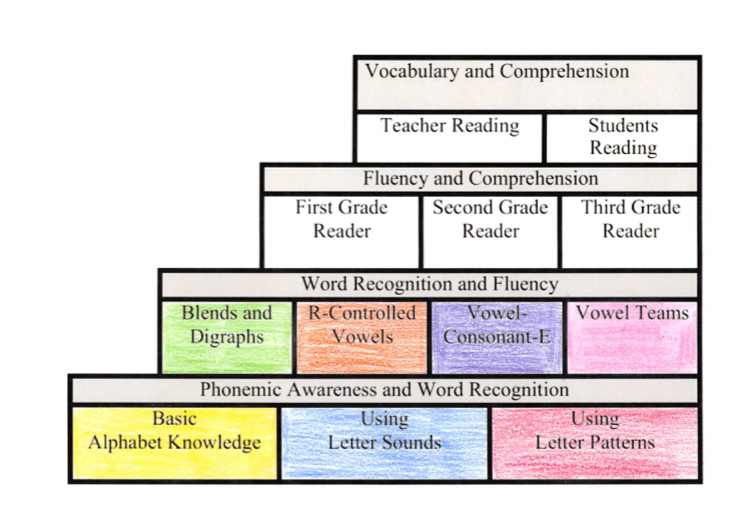
DI Groups
(Differentiated Instruction)
What is DI and where should my child be at the end of the year?
Small group instruction
Based upon student’s needs
Phonics, fluency, and comprehension based.
End of year goal:
Letter Sounds

Slide 18
Math Standards
Know number names and the count sequence (1-100 by 1s and 10’s).
Count to tell the number of objects.
Understand addition as putting together and adding to and understand subtraction as taking apart and taking from.
Work with numbers 11–19 to gain foundations for place value.
Describe and compare measurable attributes.
Classify objects and count the number of objects in categories.
Identify and describe shapes.
•Analyze, compare, create, and compose shapes.

Slide 19
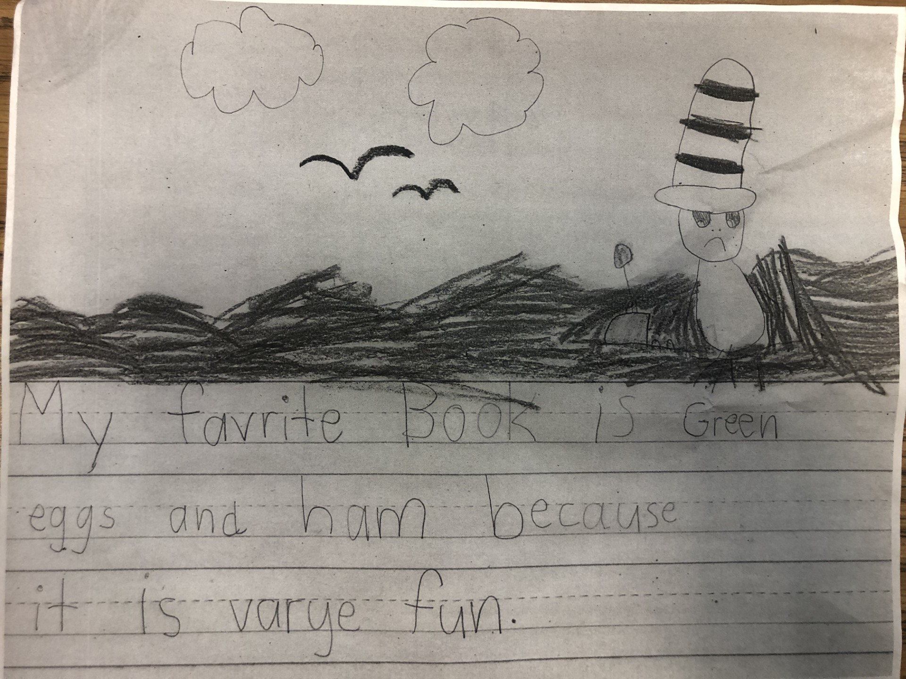
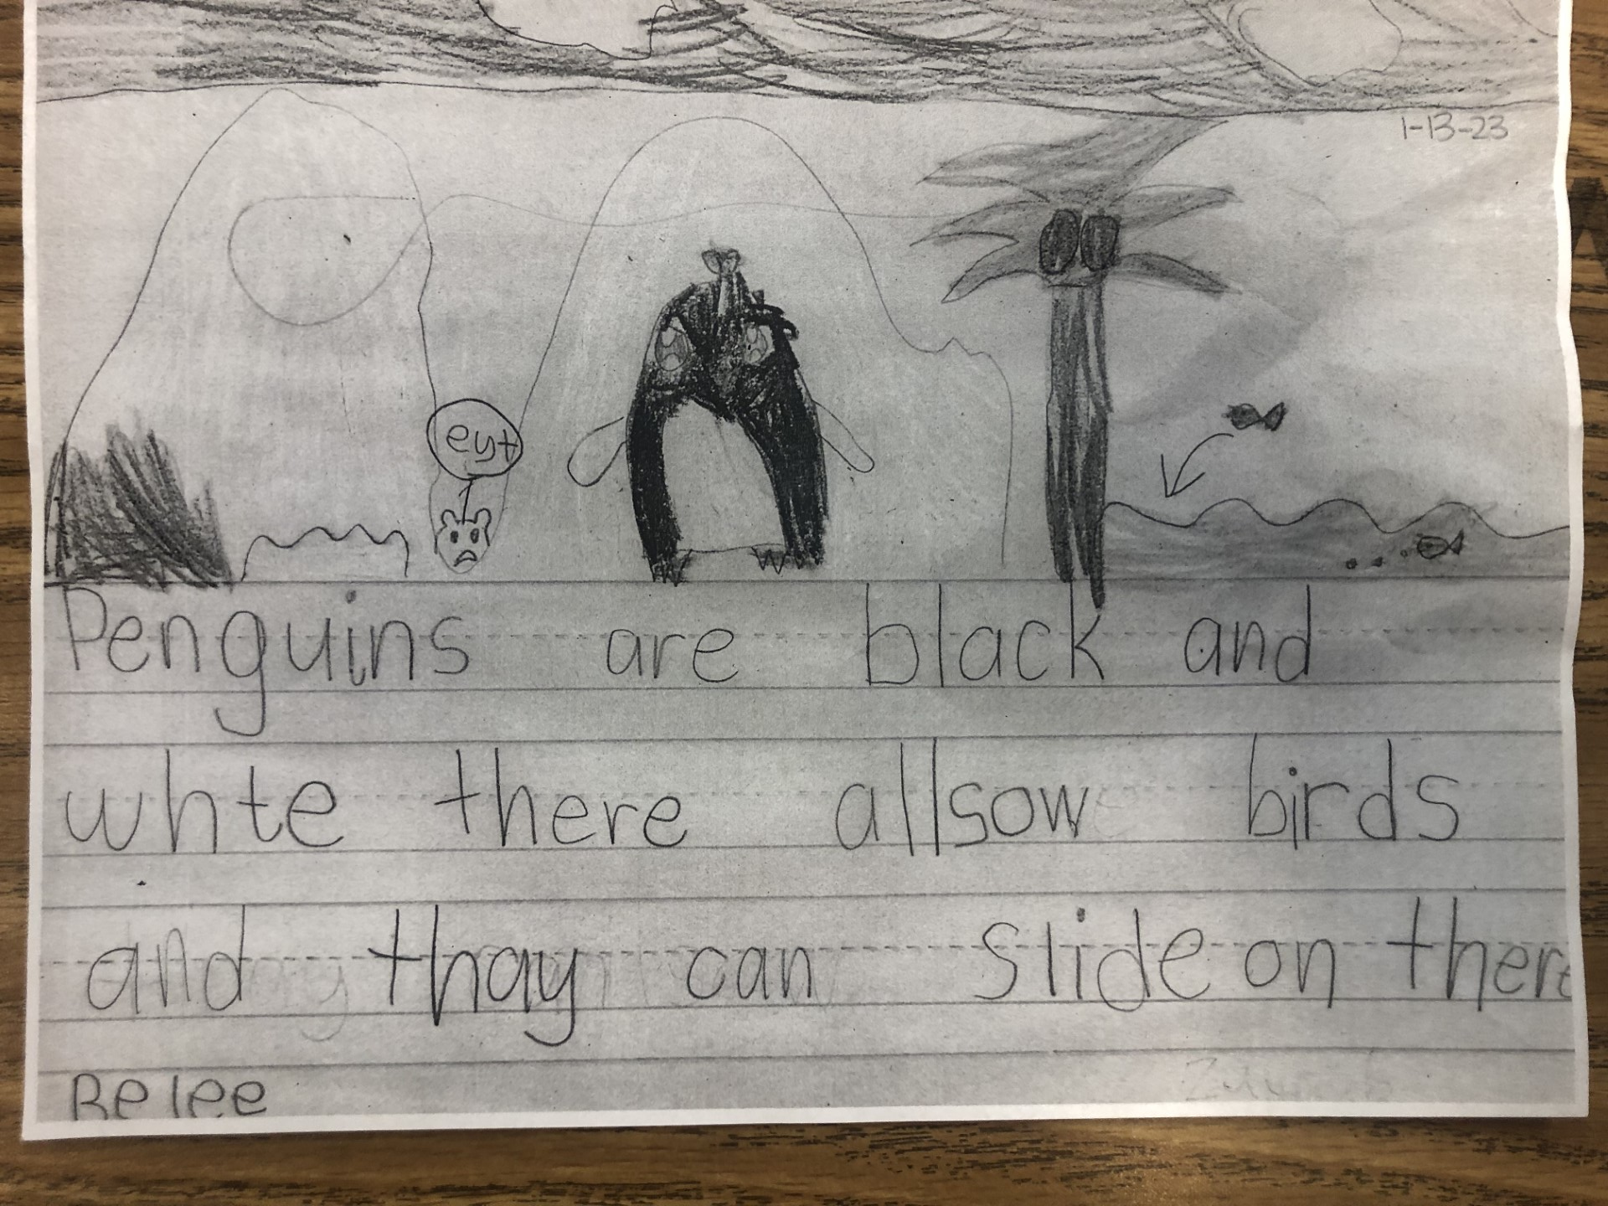
K Writing Samples

Slide 20
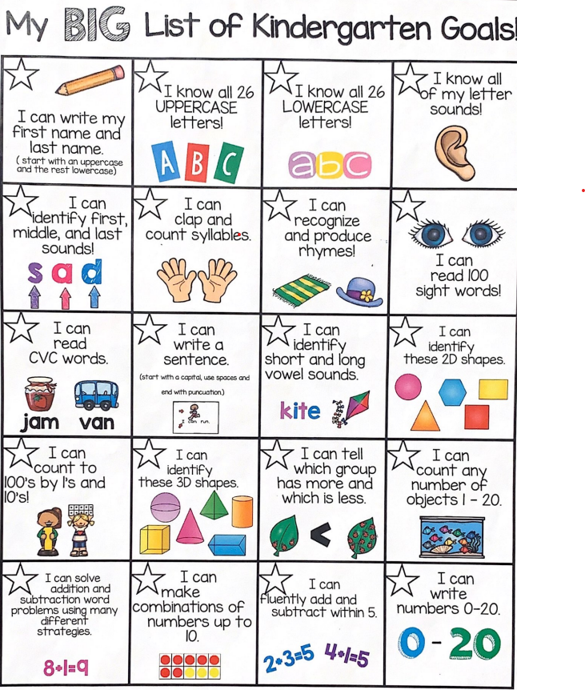
Kindergarten
End
Of year goals

Slide 21
Questions
Do you have any lingering questions?
~If so, please reach out to your child's teacher!
Thank you for taking the time to learn all about kindergarten at Baggett! We look forward to an amazing year!

