Slide 1
Sight, COLOR, LENSES, and MIRRORS
December 4th

Slide 2
REVIEW
What do you remember?

Slide 3
December 4th 2015 page 111
DO: I will be able to explain the nature of waves, their behaviors and characteristics as they are manipulated by mirrors and lenses.
EQ:
How do mediums effect our perception of waves?
Explain how optical illusions work.

Slide 4
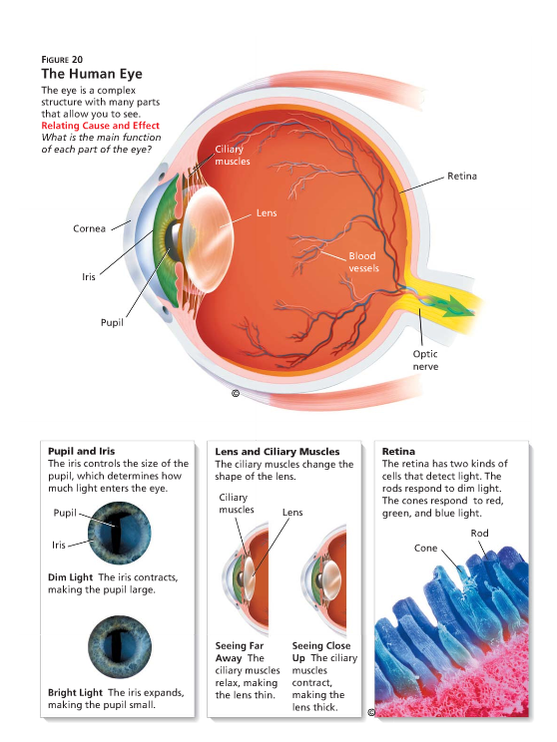
HOW Humans see

Slide 5
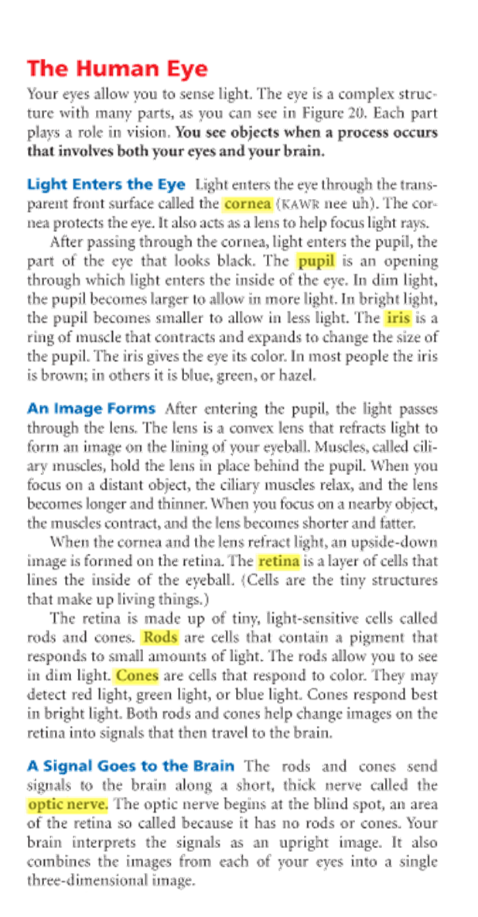
HOW Humans see

Slide 6
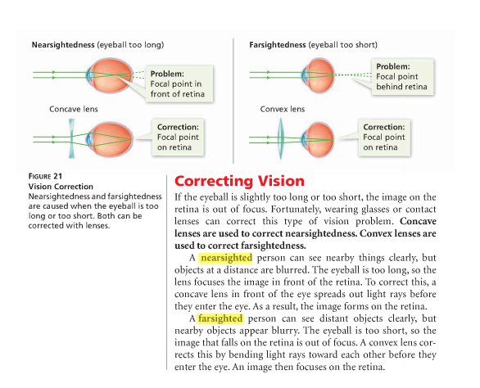
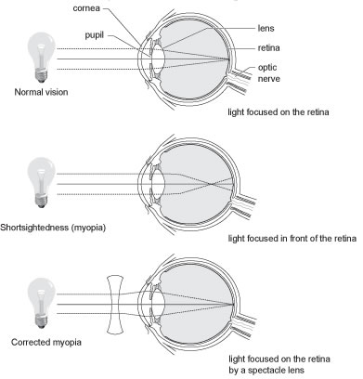
HOW Humans see

Slide 7
REVIEW

Slide 8
What’s New
Are you taking notes?
You should be…

Slide 9
December 7th 2015 page 113
DO: I will be able to explain the nature of waves, their behaviors and characteristics as they are manipulated by mirrors and lenses.
EQ:
How do mediums effect our perception of waves?
Explain how optical illusions work.

Slide 10
REVIEW

Slide 11
REVIEW
A disturbance that transfers energy from place to place.

Slide 12
Mirrors and Lenses
When parallel light rays strike a smooth surface, all of the rays are reflected at the same angle.
The side mirror on a car it enlarges the viewing field of a driver but images are smaller and may seem to be further away.
A convex lens is thicker in the center than on its edges. As light rays parallel to the optical axis pass through a convex lens, they are bent toward the center of the lens. Examples: Magnifying glass and corrective lenses for farsightedness.
A concave lens is thinner in the center than on its edges. When light rays traveling parallel to the optical axis pass through a concave lens they bend away from the axis and never meet. Example : Expanding an image to extend the focal point further back in a eye to correct nearsighted vision.
Concave mirrors reflect parallel light rays so that they meet at a point. Concave mirrors produce the magnified images that you see in a makeup mirror.

Slide 13
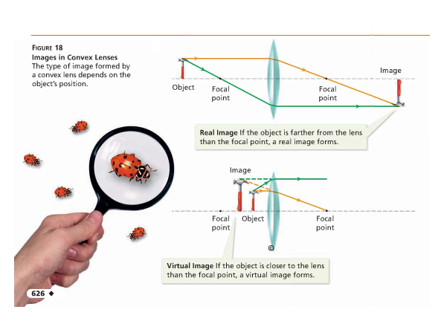
Convex Lenses

Slide 14
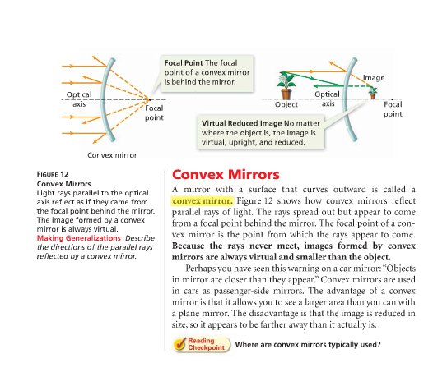
Convex MIRRORs

Slide 15
Concave Lenses

Slide 16
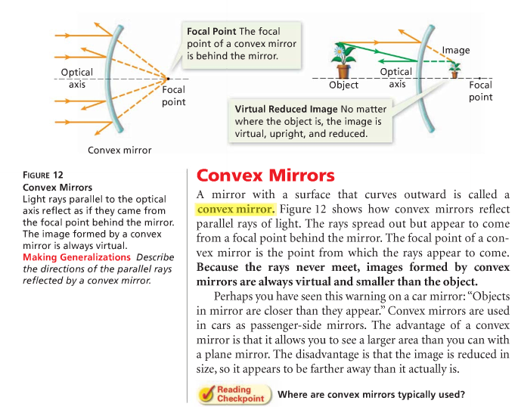
Concave MIRRORs

Slide 17
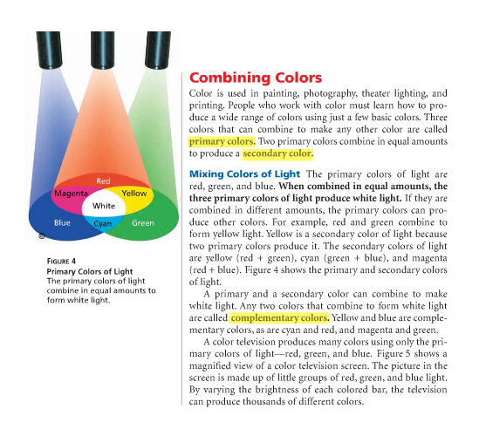
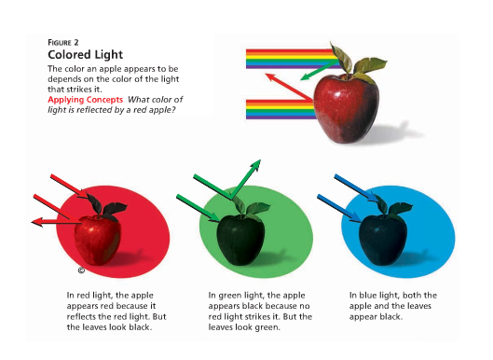
COLOR

Slide 18
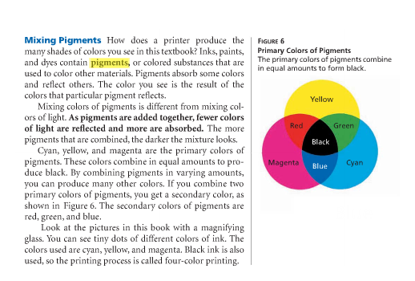
COLOR

Slide 19
December 8th 2015 page 115
DO: I will be able to explain the nature of waves, their behaviors and characteristics as they are manipulated by mirrors and lenses.
EQ:
How do mediums effect our perception of waves?
Explain how optical illusions work.

Slide 20
December 8th 2015 page 115
Use the diagram below to answer this question.
1. When a rock is dropped into a large puddle,
A. the energy of the waves is greatest at the center of the puddle.
B. the energy of the waves is greatest at the edge of the puddle.
C. the medium moves out with the energy.
D. the energy of the waves doesn't change as they move away from the center of the puddle.
2. The leaves on a tree appear to be green because the molecules of the leaves
A. emit only green light.
B. absorb only green light.
C. absorb all colors except green.
D. reflect the light back unchanged.
3. You are sitting on the edge of a pool with your legs in the water. As light waves pass from the pool into the air, it looks like your legs are not attached at the knees where they meet the water. This is because light waves _______________ when they pass from one medium to another.
A. are amplified
B. diffract
C. reflect D. refract

Slide 21
THEMATIC CONNECTION

Slide 23
Prepare for QUIZ
HOW DO YOU HEAR?
HOW DO YOU SEE?

Slide 24
QUIZ
Explain the simple steps of how a human Hears and Sees. (6 steps)
BONUS:
Explain how waves and energy effect the perceptions of what humans hear and see.

Slide 25
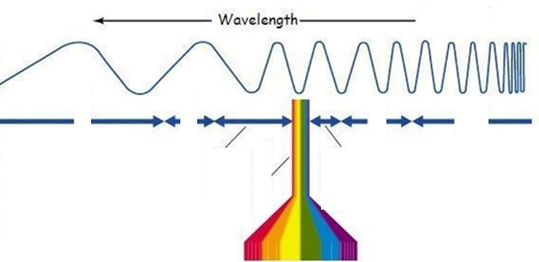
December 14th 2015 page 115
1. Waves with short wavelengths have __________ frequencies.
A. High B. Low C. Medium D. Undeterminable
2. Give an everyday example for Each
A. Conduction
B. Convection
C. Radiation
3. Draw and explain the difference between:
A. Transmission
B. Reflection
C. Refraction D. Diffraction

