Slide 1
August 24th 2016
RIGHT NOW
Please get out a pencil/pen your notebook, folder, and any signed forms.
Before class begins write down what the focus of our work time today is as well as your homework.
WT: Quiz, video, and Notes
Closure: This is like that…
HW: Review your notes!
Matter Project.
Warm Up:
Prepare for your Quiz.
Can you:
Explain phase change
Identify and explain physical and chemical properties and changes
Explain the Law of Conservation of Matter
Balance Equations
I will be able to:
I will be able to identify and explain the difference of atoms and molecules, as well as create a Bohr model of an atom correctly structuring critical components of an atom.
EQ:
How are valence electrons helpful in bonding?
What are the maximum number of electrons in the first three energy levels of an atom?
What is the correlation between protons, and electrons in an atom?
Why do we say atoms are neutral?
Where is most of the mass of an atom found?

Slide 2
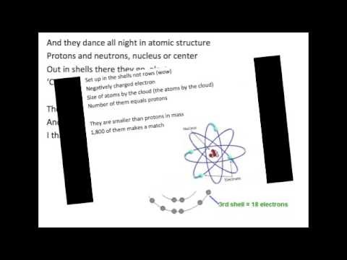

Slide 3
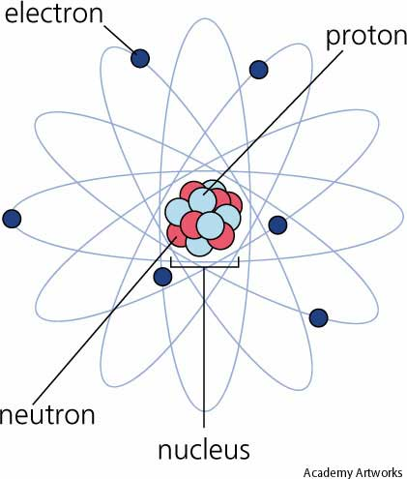
Atoms, Elements, Molecules, and Compounds!

Slide 4
Atoms
The building blocks of matter!
the basic unit of a chemical element
Composed of charged particles called electrons, protons, and neutrons

Slide 5
Location of Subatomic Particles
ATOM
Electrons
Neutrons
Protons
ATOMS have NO charge because protons and electrons are positive and negative charges and are equal in number.
nucleus

Slide 6
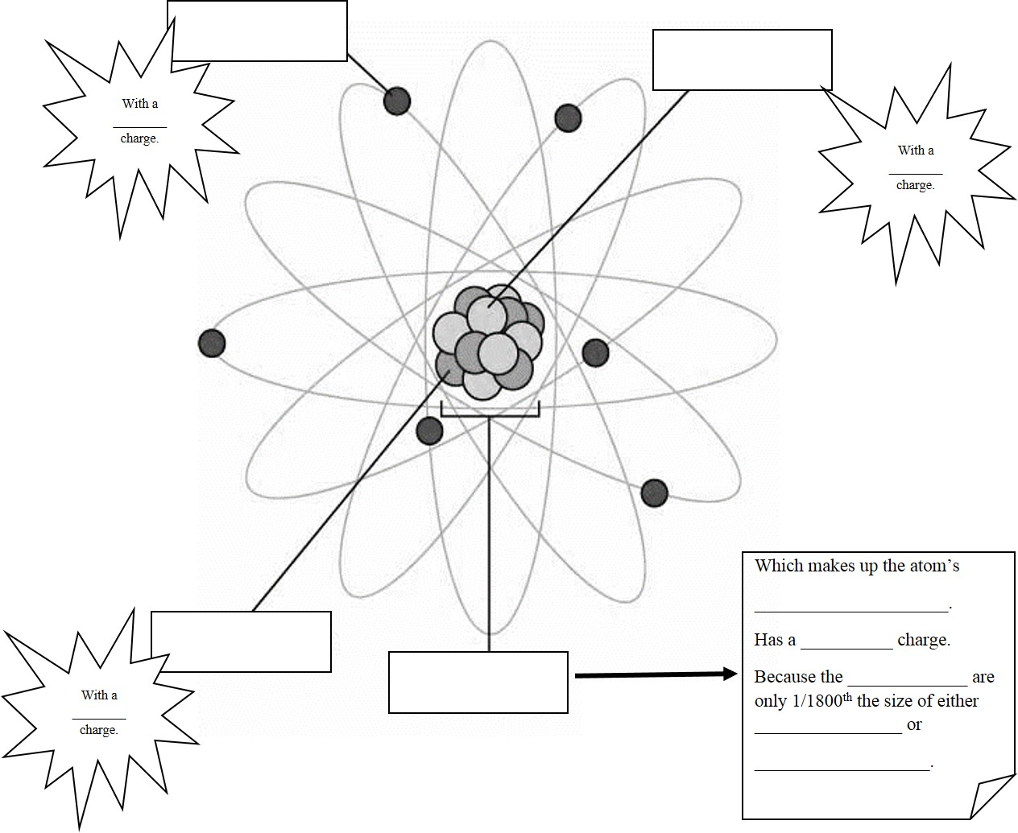
Electron
Protons
-
+
+
+
+
+
+
Because electrons(-) = protons (+)
there is no charge in ATOM as a whole unit.
Atomic mass
+
electrons
Protons
neutrons
Neutron
NO

Slide 7
August 25th 2016
Warm Up:
This is like that…
An atom is like a ________ because…
I will be able to:
I will be able to identify and explain the difference of atoms and molecules, as well as create a Bohr model of an atom correctly structuring critical components of an atom.
EQ:
How are valence electrons helpful in bonding?
What are the maximum number of electrons in the first three energy levels of an atom?
What is the correlation between protons, and electrons in an atom?
Why do we say atoms are neutral?
Where is most of the mass of an atom found?
RIGHT NOW
Please get out a pencil/pen your notebook, folder, and any signed forms.
Before class begins write down what the focus of our work time today is as well as your homework.
WT: Notes
Closure: TOD sheet
HW: Review your notes!
Matter Project.

Slide 8
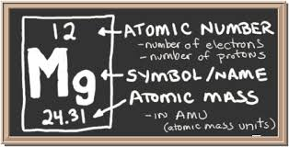
Element
A substance that cannot be separated into simpler substances by chemical means
Explanation for how one particular atom behaves
(the “script” or classification of an atom with all the
critical information about that atom)
Ex: C (carbon), H (hydrogen),
Na(sodium), Fe (iron), and
Cl (chlorine)
Element Square

Slide 9
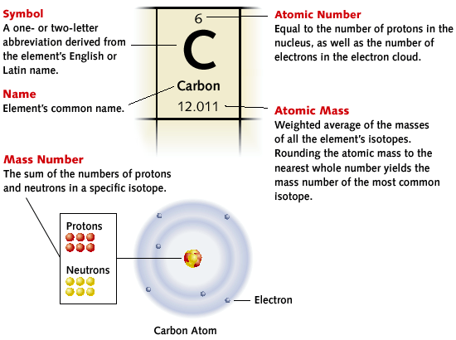
The Element Square
6 protons, 6 electrons =
12 total mass of Protons and Neutrons; use the atomic number to subtract Protons from the total to find out Neutrons.
12 total - 6 Protons =6 Neutrons

Slide 10
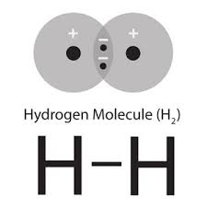
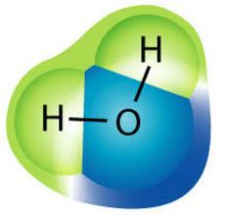
Molecules
A molecule is a group of two or more atoms that stick together chemically
Ex: H2, CO2, and H2O
Example Molecule: 2 Atoms of the same Element
Example Molecule: 3 Atoms of different Elements

Slide 11
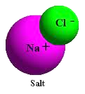
Compounds
A compound is a molecule that is made from at least two different elements.
Ex: H2O, CO2, CH4, and CH3COO
Ex:
NaCl = sodium chloride Na = sodium Cl = chlorine
H2O = water H = hydrogen O = oxygen

Slide 12
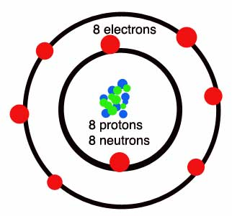
Nature of Matter:
The Atom
The nucleus holds two types of particles in it: neutrons and protons.
Since the neutron has no electric charge, and the proton has a +1 charge, the nucleus has an overall +1 charge.
Most of the mass of an atom is located here in the nucleus.
The center of the atom is called the
Nucleus

Slide 13
NUCLEUS
ENERGY LEVEL/SHELLS
A neutron has no electrical charge associated with it, we say it has a charge of 0.
A neutron is found in the nucleus only.
Electrons are very small particles located outside the nucleus. They orbit (circle around) the nucleus at high speeds, like the Earth orbits the sun.
An electron has an electrical charge of –1.
Electrons orbit on rings or energy levels. The outside ring is called the “valence shell”
The valence shell is where one atom bonds together with another atom.
A proton always has an electrical charge of +1 amu.
A proton is found in the nucleus only
The nucleus of an atom gets its overall charge from the proton.

Slide 14
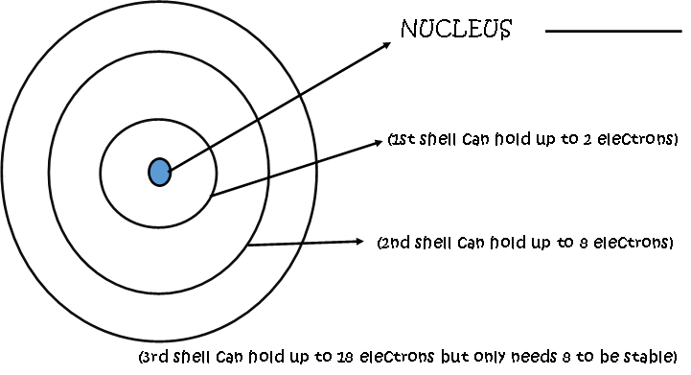
Energy Shells

Slide 15
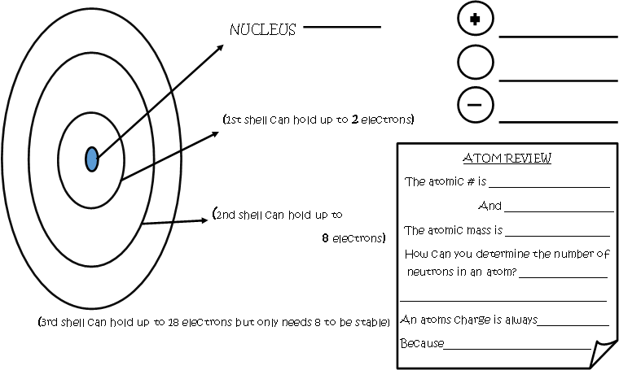

Slide 16
Explain the statement:
All compounds are molecules but not all molecules are compounds

Slide 17
Molecules can consist of two of the same elements. Compounds can not!
Ex: H2 is a molecule, but not a compound because there is only one kind of element combined

Slide 18
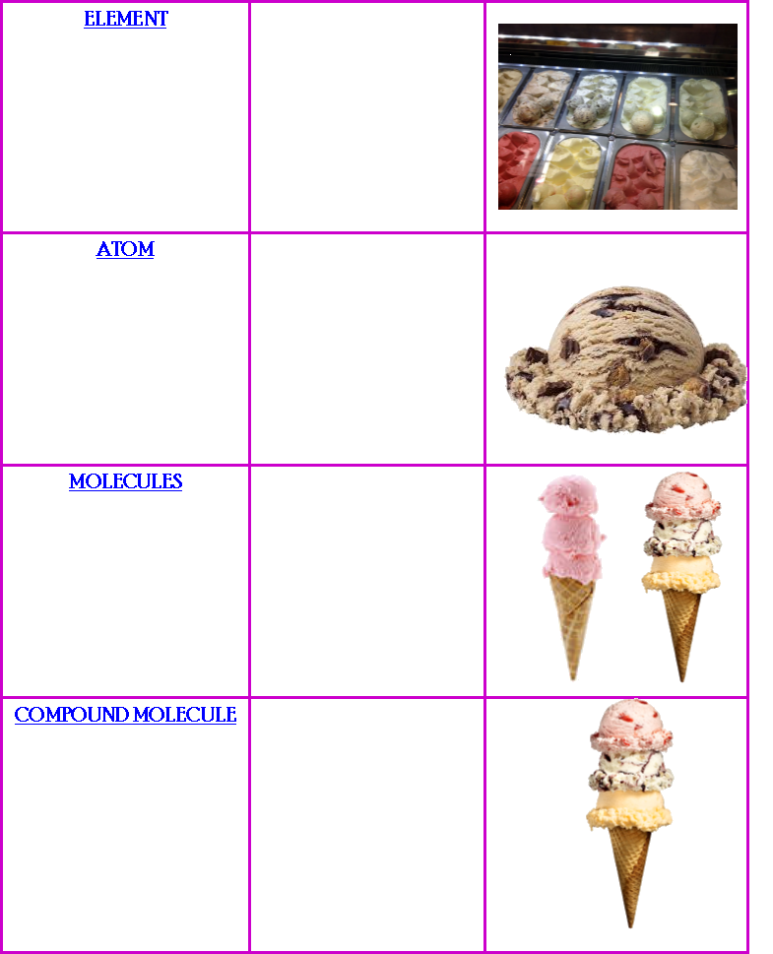
Explain the connection….

Slide 19
DO: I will be able to differentiate between atoms, elements, molecules, and compounds.
EQ:
How are molecules created?
Explain this statement: All compounds are molecules but not all molecules are compounds.

Slide 20
Check Yourself Questions
1.The melting point and boiling point of silver are 960 degrees C and 1950 degrees C respectively. What is the freezing point of silver?
0 degrees C
100 degrees C
960 degrees C
1950 degrees C
2. Which of the following is an element?
NaCl
Fe3O2
OH
Fe

Slide 21
1. Sodium is an element found in table salt. It contains 11 protons and 12 neutrons. How many electrons are found in a neutral atom of sodium?
11
12
23
1
Explanation:
2. What does the law of conservation of matter state?
The total mass of the reactants is greater than the total mass of the products.
The total mass of the reactants is less than the total mass of the products.
The total mass of the reactants equals the total mass of the products
Matter can not change form.
Explanation:

Slide 22
Daily Checks
1. Sodium is an element found in table salt. It contains 11 protons and 12 neutrons. How many electrons are found in a neutral atom of sodium?
11
12
23
d.1
2. What does the law of conservation of matter state?
The total mass of the reactants is greater than the total mass of the products.
The total mass of the reactants is less than the total mass of the products.
The total mass of the reactants equals the total mass of the products
Matter can not change form.
11
Na
23
Protons(11) = Electrons (11)
Starting Mass = Ending Mass
Reactants = Products

Slide 23
