Slide 1
Vocabulary 3.3
Light
You will need 10 index cards.

Slide 2
CCGPS
S8P4. Students will explore the wave nature of electromagnetic radiation.
b. Describe how the behavior of light waves is manipulated causing reflection, refraction, diffraction, and absorption.
c. Explain how the human eye sees objects and colors in terms of wavelengths.

Slide 3
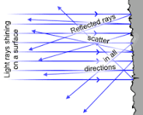
Diffuse Reflection
The reflection of light from a surface so that the ray is reflected at many angles rather than at just one angle.

Slide 4
Regular Reflection
If the reflecting surface is very smooth, the reflection of light that occurs is called specular or regular reflection.

Slide 5
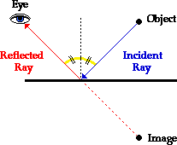
Normal Line of Reflection
At the point of incidence where the ray strikes the mirror, a line can be drawn perpendicular to the surface of the mirror. This line is known as a normal line.
The normal line divides the angle between the incident ray and the reflected ray into two equal angles.

Slide 6
Law of Reflection
States that the angle of incidence equals the angle of reflection.
http://study.com/academy/lesson/what-is-a-concave-mirror-definition-uses-equation.html

Slide 7
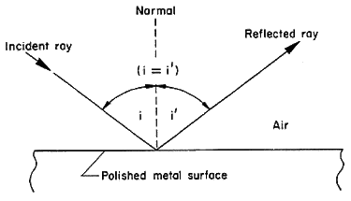
Angle of Incidence
The point that the light ray strikes the surface.

Slide 8
Angle of Reflection
Reflection occurs when a light ray hits a surface and bounces off. The angle at which the ray hits the surface is equal to the angle at which it bounces off.

Slide 9
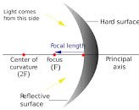
Concave Lens
Having an outline or surface that curves inward like the interior of a circle or sphere.

Slide 10
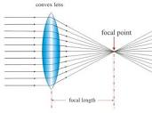
Convex Lens
Having an outline or surface curved like the exterior of a circle or sphere.

Slide 11
Lenses Explained
https://www.youtube.com/watch?v=4zuB_dSJn1Y]

Slide 12
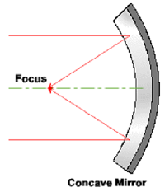
Concave Mirror
When the surface is bulging inward.

Slide 13
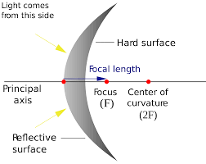
Convex Mirror
A convex mirror, fish eye mirror or diverging mirror, is a curved mirror in which the reflective surface bulges toward the light source. Convex mirrors reflect light outwards, therefore they are not used to focus light.

Slide 14
Convex and Concave Mirror Explained
https://www.youtube.com/watch?v=jtTBOMVMSYM

Slide 15
Quizlet
https://quizlet.com/172954722/vocabulary-33-waves-light-flash-cards/?new

