Slide 1
Magnetism and Electricity Vocabulary On-Level
Week 3

Slide 2
S8P5c Electromagnetism: Investigate and explain that electric currents and magnets can exert force of each other.

Slide 3
Voltage
The difference in electrical potential energy and two places in a circuit.
Voltage is the electric force that causes the free electrons to move from one atom to another.
Think of it as the amount of force pushing an electric current.
https://www.youtube.com/watch?v=sOoNJXqyBGM

Slide 4
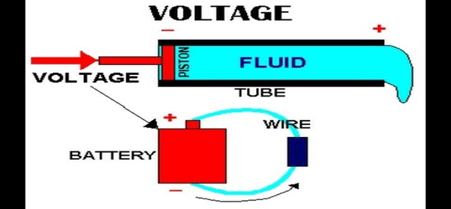
Voltage Continued
Just like water needs pressure to force it through a hose, electrical current needs some force to make it flow. A volt is the measure of electric pressure. Voltage is usually supplied by a battery or a generator.

Slide 5
Ohm’s Law
States that resistance is equal to voltage divided by current.
Resistance = Voltage/Current
https://www.youtube.com/watch?v=iLzfe_HxrWI

Slide 6
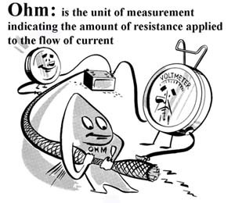

Slide 7
Ampere
An ampere is a unit of measure of the rate of electron flow or current in an electrical conductor.
The ampere is named after Andre Marie Ampere, French physicist (1775-1836).
Electrical current is measured in amperes or "amps" for short. Amperes is like the amount of water flowing through a hose in a certain amount of time or the amount of electricity flowing through a wire.
The scientific symbol for amps is the letter "I".
https://www.youtube.com/watch?v=8gvJzrjwjds

Slide 8
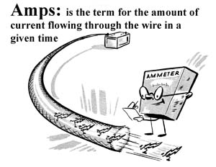

Slide 9
D/C – Direct Current
This is a current in which the charges flow in only one direction.
It can be created from a changing magnetic field or energy source like a battery.
https://www.youtube.com/watch?v=g17f9J1-r-k

Slide 10
A/C – Alternating Current
Alternating Currents consist of charges that move back and forth in a circuit.
The electric current in homes, schools, are alternating currents.
A/C Voltage can be easily raised or lowered. High voltage sends a current over longer distances. It can be reduced for basic, everyday use.
https://www.youtube.com/watch?v=vN9aR2wKv0U

Slide 11
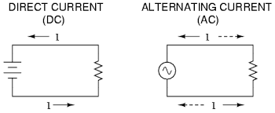

Slide 12
Generator
An electric generator is a device that converts mechanical energy obtained from an external source into electrical energy as the output.

Slide 13
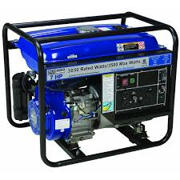

Slide 14
Motor
An electric motor is a device that uses an electric current to turn an axle.
An electric motor transforms electrical energy into mechanical energy.
https://www.youtube.com/watch?v=mzyDNpG07AU

Slide 15
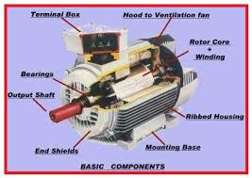

Slide 16
Electromagnet
A magnet created by wrapping a coil of wire with a current around a ferromagnetic core.
The magnetic field is produced by both the current in the wire and the magnetized core.
It is a strong magnet that can be turned on and off.
https://www.youtube.com/watch?v=emlzh9XXWgQ

Slide 17
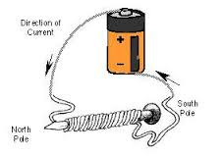

Slide 18
Summary
https://www.youtube.com/watch?v=20Vb6hlLQSg

Slide 19
Quizlet
https://quizlet.com/_2yhldy

