Slide 1
Environmental Issues of Latin America
SS6G2

Slide 2
Warm-Up 1/21/16
Out of the three environmental issues we have talked about (air pollution in Mexico City, oil pollution in Venezuela, and deforestation of the Amazon Rainforest), which do you think is the worst? Why?
You must give specific examples and use your vocabulary words.

Slide 3
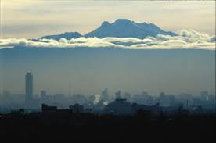
Air Pollution of Mexico City
Smog: Factory smoke + car exhaust + sunlight/heat creates an air polluted thick cloud (fog)

Slide 4
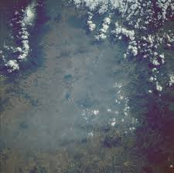
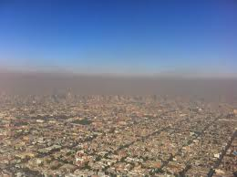
Air Pollution in Mexico City
Largest Environmental Concern
Mexico City has bad SMOG issues
Air is thin, hot, dry, and without wind, so the smog is trapped and low to the ground

Slide 5
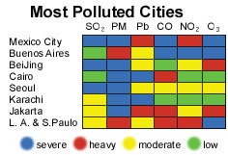
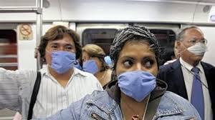
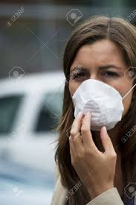
Air Pollution of Mexico City
Latin America has a statistic of the most unhealthy People in Mexico City for breathing problems and lung disease.
Real-Life Situation:

Slide 6
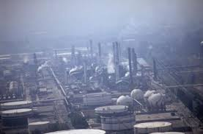
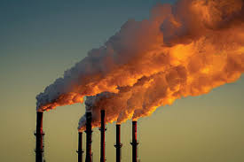
Air Pollution of Mexico City
Causes:
The mountains trap the air flow in
Near Equator (in tropics) -> so intense heat and sunlight
Thousands of factories creating pollution
Limited $; low economy
Relaxed government enforcing laws

Slide 7
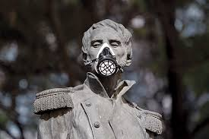
Air Pollution of Mexico City
Effects:
Breathing problems and lifelong diseases
High medical costs
High infant mortality rate
Contaminated/poor quality agriculture
Seafood, plants, etc. = lowered economic standing
Acid Rain
And its natural effects on everything
Limited outside activity (especially with kids)
Companies limited by laws from government

Slide 8
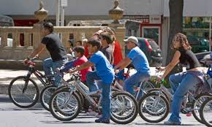
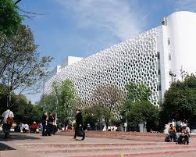
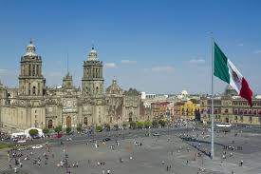
Air Pollution in Mexico City
Solutions:
Can’t drive 1 day a week (different for each citizen)
Factories sometimes forced to close
Public transportation and riding bikes
Required emissions testing yearly
Cleaner fuels/cars encouraged

Slide 9
Air Pollution in Mexico City (draw picture here)

Slide 10
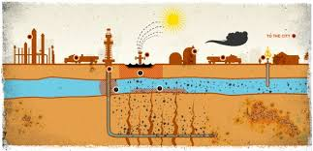
Oil-Related Pollution in Venezuela
Fracking/Hydro-Fracking: horizontal (sideways) drilling into the soil/rock. Very deep wells. Creates a pipe to safely suction the oil/gas out to the surface. It’s safe and contained so to prevent spills and gasses in the air.

Slide 11
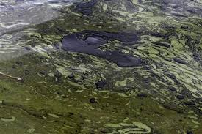
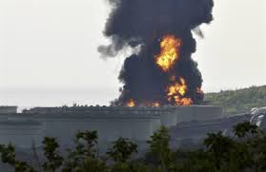
Oil Pollution in Venezuela
Largest Environmental Concern:
Big oil companies are run by the government (public businesses) and fueled by money, instead of safety
Overproduction and unsafe conditions

Slide 12
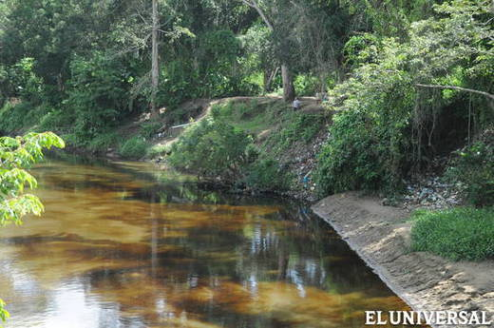
Oil Pollution in Venezuela
Real-Life Example:
Under Chavez’ presidency, the number of oil related deaths and spills rose. So he replaced the oil company workers with loyalists (people who only care about what Chavez wants)
Because of major spills, people go without water or it is contaminated
2012: 550,000 people without water for months

Slide 13
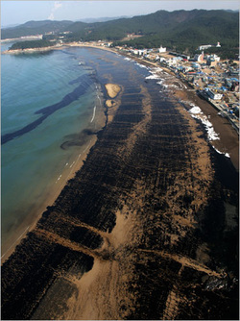
Oil-Related Pollution in Venezuela
Problem:
Oil pollution and carbon dioxide in the air and water. Caribbean Sea and Venezuela’s coast polluted with oil.

Slide 14
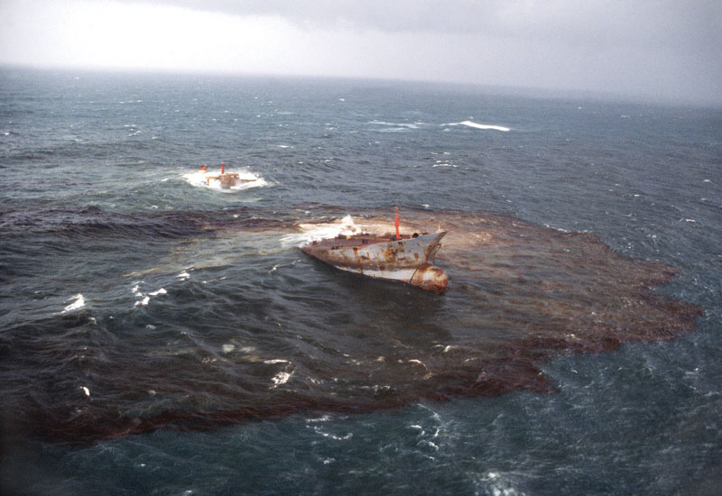
Oil-Related Pollution in Venezuela
Causes:
Huge demand for oil (can’t slow down or stop extraction).
Needed $ for economy (50% of Venezuela’s GDP)
5th largest exporter of oil
Oil spills and tanker leaks
Newly hired workers and managers may not be well educated
Machines are old and not reliable

Slide 15
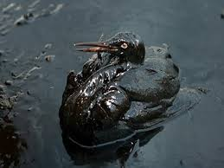
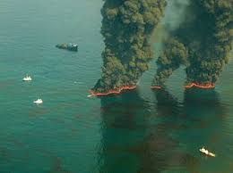
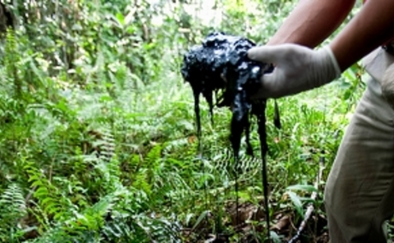
Oil Pollution in Venezuela
Effects:
Contaminates water for people, animals, and plants (food)
Starts fires
Expensive to clean up and takes a long time
Human deaths due to accidents
Socialist Party politics running oil

Slide 16
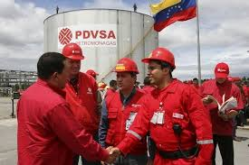
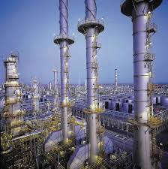
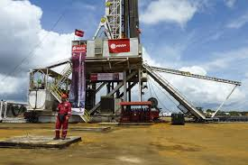
Oil Pollution in Venezuela
Solutions:
Decrease the need for oil (demand from other countries-even the USA)
Increase environmental protection laws
Hold oil companies responsible for decisions and spills

Slide 17
Warm-Up 1/26/16 True or False?
1. The Sierra Madre Mountains help Mexico City’s air pollution problem.
2. Mexico City is at a high elevation and thus the air is already thin there.
3. Citizens in Mexico City suffer from more breathing diseases than any other city on earth.
4. Venezuela’s oil pollution problems got worse during Chavez’ presidency as unskilled workers replaced skilled ones and spills happened more often.
5. Clean water is limited in Venezuela, and sometimes (during a spill) those not in the city have to go without.
6. The main cause of deforestation is the logging industry/exporting of lumber.
7. Over half of the Amazon Rainforest is already gone.
8. The world depends on the Amazon for about 20% of its oxygen.
9. All of the environmental concerns that we learned about are man-made problems that center around a desire for making money and creating a stable economy.
10. All of the environmental issues that we have learned about effect the global environment and climate change.

Slide 18
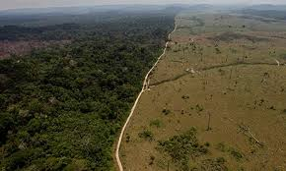
Deforestation in the Amazon Rainforest
Largest Environmental Concern
Deforestation in Brazil’s Amazon area
Extraction of natural resources
Humans are removing trees for livestock, logging, and agriculture $$

Slide 19
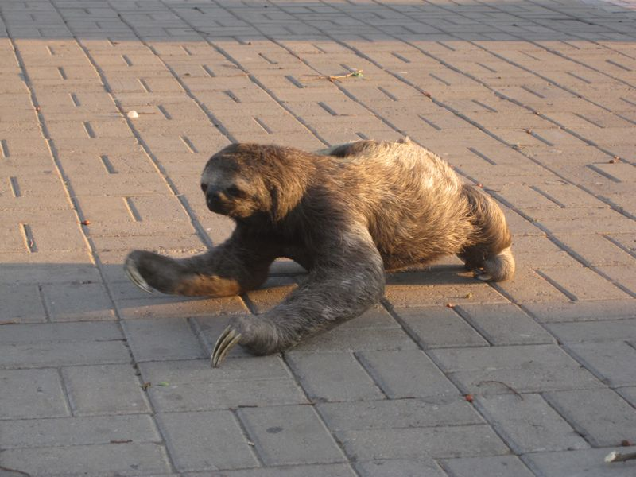
Deforestation of the Amazon Rainforest
Real-Life Situations
Animals (like sloths) are being found in cities because their home was taken
Plants and animals are going extinct
Global warming and less oxygen produced each year (20% of the world’s oxygen comes from the Amazon!!)

Slide 21
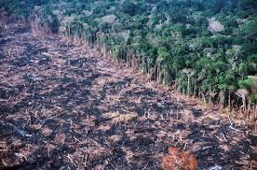
Deforestation of the Amazon Rainforest
Causes
Money!!
Natives and Brazilians cut down trees to use land and sell the trees (cattle ranching, agriculture, and logging)

Slide 22
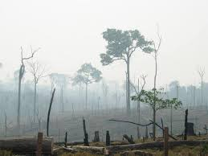
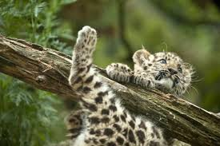
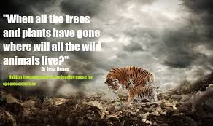
Deforestation of the Amazon Rainforest
Effects
Less world oxygen
Global warming
Loss of homes
Extinct plants and animals
Rainforest diminishes

Slide 23
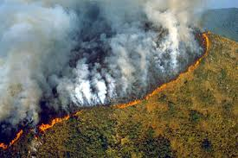
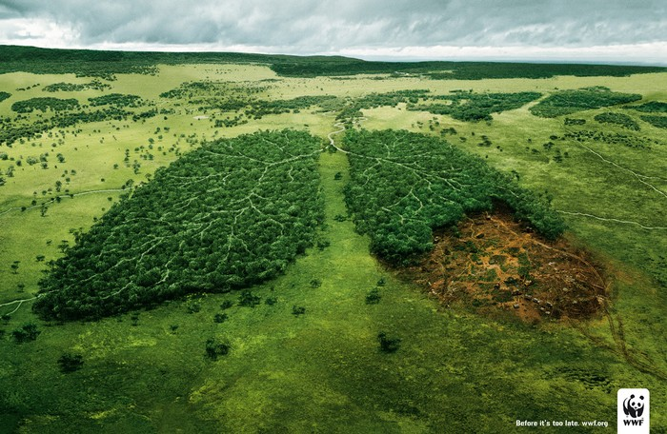
Deforestation of the Amazon Rainforest
Solutions
Government laws of where and how much land can be taken (QUOTA)
Other jobs and skills to give natives other job options
Global information and awareness campaigns

