Slide 1
Ritch Middle School
Dress Code Policy
2016- 2017

Slide 2
Ritch Middle School students will be expected to be in dress code beginning the first day of school.
Raven Wear

Slide 3
The Philosophy
All students are expected to dress in a manner consistent with the recognition that he/she has a responsibility to help foster a learning environment that promotes health and safety, respect and pride, and a positive regard for district policy.

Slide 4
Shirts & Blouses
• Shirts and blouses should cover a majority of the shoulder. Sleeveless apparel with a finished edge may be worn if the garment has a standard size armhole.
• Spaghetti straps, tube tops, one shoulder tops, halter tops, mesh tops, sheer tops, strapless tops, racer back, and backless tops are not appropriate for school wear.
Sheer tops may be worn ONLY IF the shirt underneath meets all dress code requirements.

Slide 5
Shirts & Blouses (continued)
Shirts and blouses must NOT show inappropriate necklines that expose cleavage, low back lines, midriffs, or undergarments. No bare skin should be exposed at the waist, chest, or abdomen area.
Necklines cannot be lower than the straight line from the top of the underarm across to the opposite underarm.
All shirts and tops must be tucked in or overlap the bottom garment (pants, shorts, or skirts).
“Muscle” shirts and tank tops are prohibited on males unless they are worn with another shirt.

Slide 6

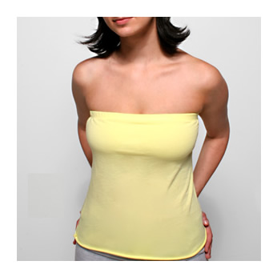
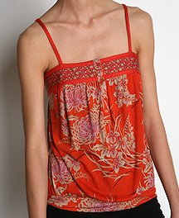
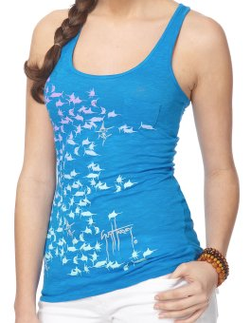
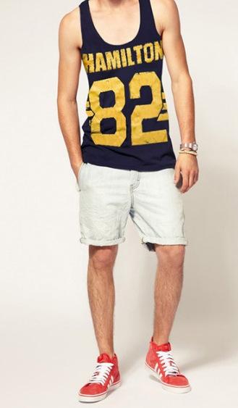

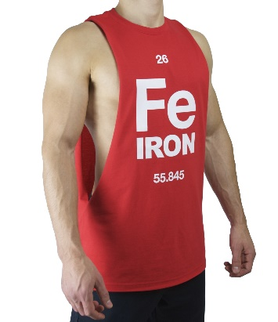
“Muscle" shirts, tube tops, one shoulder, halter tops, and spaghetti straps are not appropriate for school wear.

Slide 7
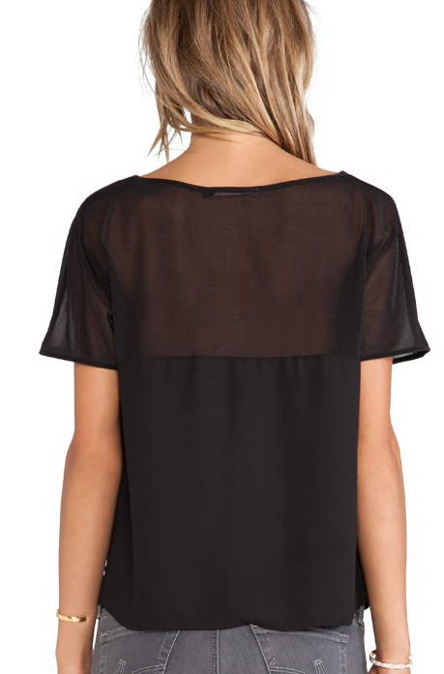
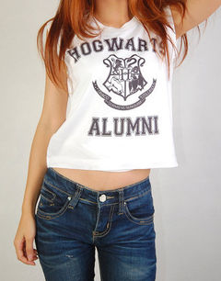

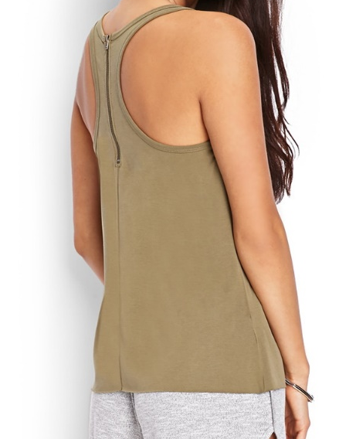
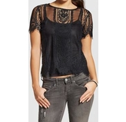
Shirts and tops that reveal cleavage, are low cut, show midriff, or are racer back or backless are not appropriate for school wear.

Slide 8
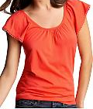
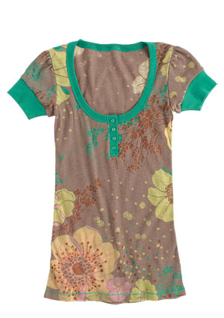

These are considered acceptable:

Slide 9
Dresses & Skirts
The shirt and blouse expectations regarding sleeves and necklines also applies to dresses.
The length of dresses and skirts, including any slit, should be no shorter than the short side of an index card (3 inches from the top of the knee) when standing up straight, front and back.

Slide 10

Index card RULE
Length of dresses and skirts, including any slits, should be no shorter than the short side of an index card when standing up straight.
Hem Line
About 3 inches
Top of knee

Slide 11
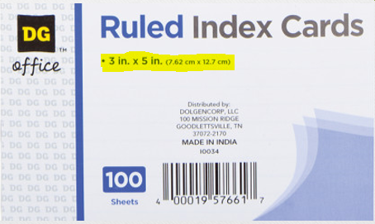
Index card RULE
Length of dresses and skirts, including any slits, should be no shorter than the short side of an index card when standing up straight.
Use this side to measure shorts.
(5 inches)
Use this side to measure skirts and dresses.
(3 inches)

Slide 12





Inappropriate Attire
You cannot pull down your skirt to lengthen it if it exposes your stomach.
The 3-inch rule should be met in both the front and back of the skirt and dress.
Exposed midriff

Slide 13
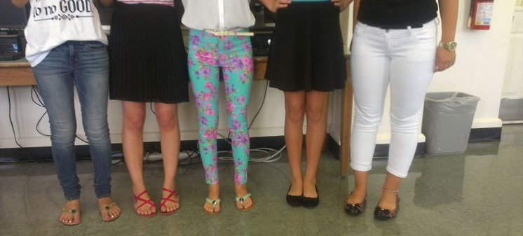
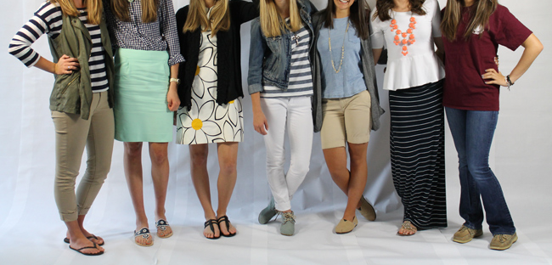
The lengths of these examples are considered acceptable.

Slide 14
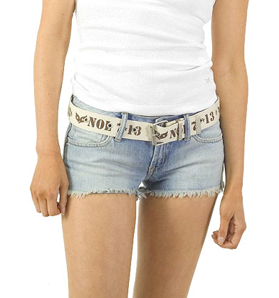
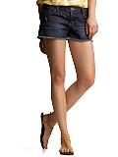
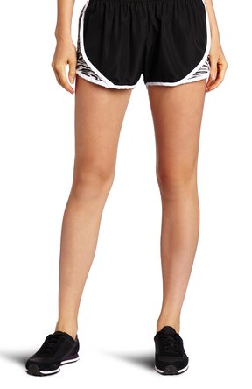
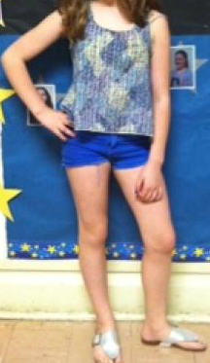
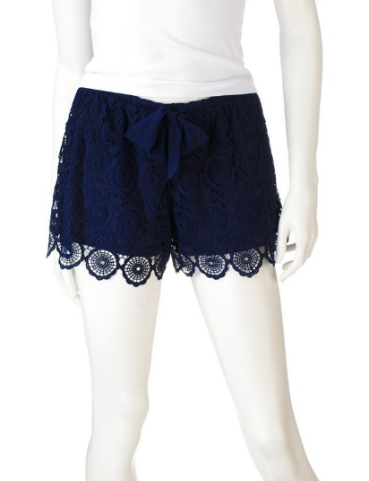
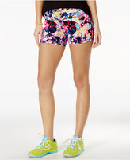
Shorts should be no shorter than the long side of an index card (5 inches) from the top of the knee (approximately mid thigh).
The lengths of these
examples are
not acceptable.

Slide 15
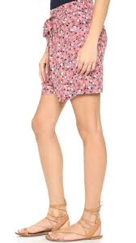
The length of these examples could be considered acceptable for school if they measure no more than
5” from the knee.
Use this side to measure shorts.
(5 inches from kneecap)

Slide 16
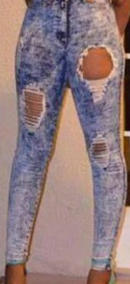
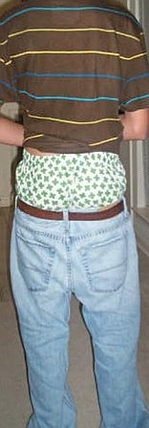
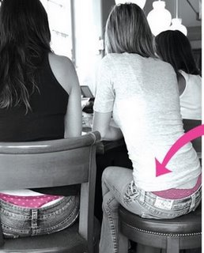
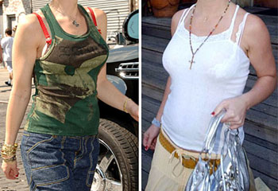
Undergarments may
NOT be exposed!
All pants, shorts, and skirts shall be worn at the waist, not sagged, and all undergarments MUST NOT be visible.
Holes should not expose skin or undergarments above the mid thigh (index card rule). Frays are OK!

Slide 17
Additional Clothing Items That Are Inappropriate for School Wear
Costumes, pajamas, or slippers.
Head wear (except for religious reasons): including hats, hoods, sweatbands, bandanas, scarves, baseball caps, picks, and combs.
Sunglasses.
Items that promote illegal or offensive activity: clothing which displays obscene words, pictures, or designs, clothing which conveys a sexually suggestive, vulgar, demeaning, or inflammatory remarks, a pro-alcohol, tobacco, or drug related message, or anything symbolic of gangs or disruptive groups.
Items that can be used as a weapon (i.e. spikes or chains).

Slide 18
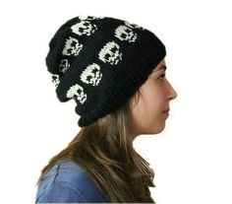

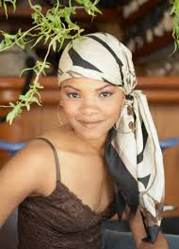
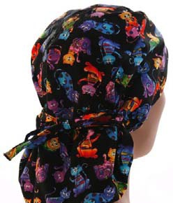


Inappropriate Headgear
Students may wear hoodies, however, the hood cannot be over his/her head during the school day inside the building.

Slide 19
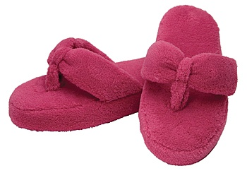
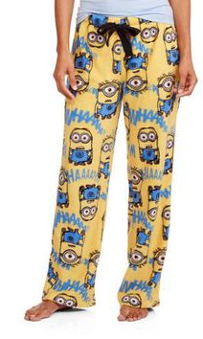
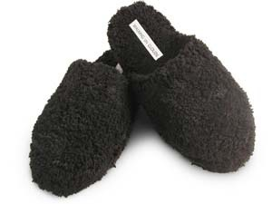
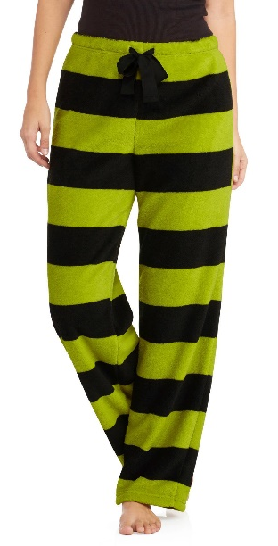
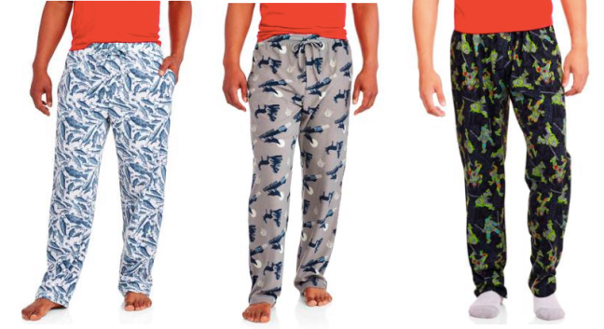
Pajamas and slippers are not appropriate for school wear.

Slide 20
Leggings
Leggings may NOT be worn with regular length shirts.
Leggings MUST be worn with a shirt or dress that hits mid thigh and covers the same length all the way around.
Leggings MUST NOT be thin (similar to tights – i.e. material that can be seen through).
Skinny jeans and skinny pants with pockets are appropriate with regular dress code approved tops as long as the bottoms are not revealing.

Slide 21
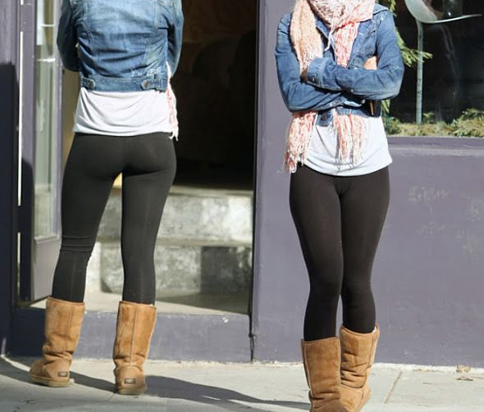
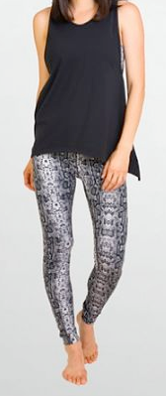
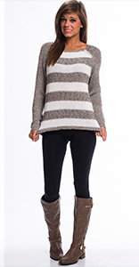
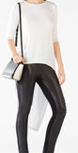

Below are examples of outfits with leggings that are NOT appropriate for school wear.
No

Slide 22
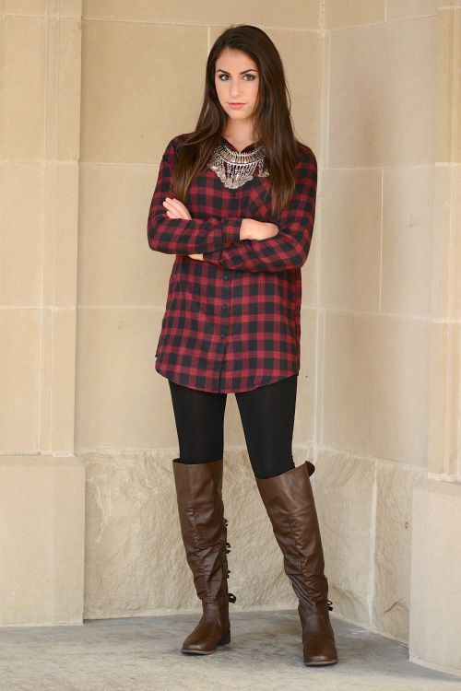
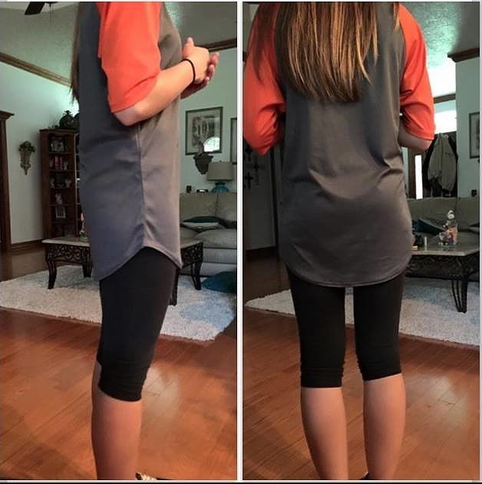

Below are outfits with leggings that are appropriate to wear to school as long as they are no more than mid-thigh.

Slide 23
Shoes and MISC.
Shoes MUST be worn at all times.
Athletic shoes MUST be worn for physical education classes.
Closed-toe shoes may be required for protection in certain activities.
ITEMS NOT SPECIFICALLY COVERED IN THE ABOVE POLICY MAY BE PROHIBITED AT THE DISCRETION OF THE SCHOOL ADMINISTRATION.

Slide 24
BE INFORMED!
Students not in dress code will be asked to attempt to call home to get a change of clothes brought to them.
Students who are unable to get a change of clothes may be asked to sit in ISS for the day and teachers will provide class work for them to complete.
Students with habitual dress code violations will be subject to disciplinary action for defiance of district policy.

