Slide 1
January 5th 2016 page 119
DO:
I will be able to explain what forms electricity as well as how electricity is harnessed and used in circuits.
EQ’s:
How would you construct a series and parallel circuit?
2. Why are parallel circuits more effective than series circuits?

Slide 2
Think about it…
What makes up electricity? As electrons move what are they transferring? How do the LOCM and LOCE relate to this particular clip? Explain how the electricity is making noise.

Slide 3
Think about it…
What makes up electricity? How do the LOCM and LOCE relate to this particular clip? Explain the science of the connection between how atoms, matter, energy, waves, and electricity.

Slide 4
Electric Charges
Three particles that make up an atom:
  Protons
  Neutrons
  Electrons
POSITIVE
NEUTRAL
NEGATIVE

Slide 5


The Flow of Charges
Which subatomic particle can move from one object to another?
  Electrons!
What does the addition of electrons do to the charge of an object?
  The object will become NEGATIVELY charged.
What does the removal of electrons do to the charge of an object?
  The object will become POSITIVELY charged.
e-
e-
e-
e-
e-

Slide 6
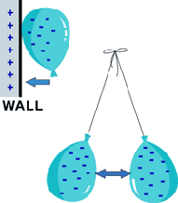
How Charges Interact
When two objects with the SAME charge come into contact, they _____________.
When two objects with DIFFERENT charges come into contact, they _____________.
repel
attract

Slide 7

Electric Current
What is an electric current?
  The continuous flow of electric charges through a material.
What is the unit of measurement for current?
  amperes (A) or amps: the amount of charge flowing past a point in a certain amount of time.
e-

Slide 8
Potential Difference
So what is Potential Difference?
  The difference in potential energy between two locations.
The difference between a rollercoaster and an electric current is that the potential difference is caused by the difference in electrical charges in two locations, not height.
High Potential Energy
Low Potential Energy

Slide 9
Potential Difference
What’s potential energy (PE)?
On a roller coaster, where does the car have more potential energy?
Can the car move from an area of low PE to high PE without the help of a motor?
It’s the same for electric current!
  The charges in a current are like the roller coaster cars.
  The track is like the wires.
  The motor that gets the cars to the top of the first hill is like the battery.

Slide 10
Potential Difference Cont.
Electric charges will always flow from a region of ___________ potential energy to a region of _________ potential energy.
When the charge reaches the negative terminal and enters the battery, it gains electric potential energy as it travels through the battery to the positive terminal.
high
low
e-

Slide 11
Voltage
What is it?
  Another term for potential difference.
What unit is used to measure voltage?
  Volts (V)
So in a 9-volt battery, when an electric charge moves from the negative terminal, through the battery, to the positive terminal, how much potential energy does the charge gain?
  9 volts!
e-

Slide 12
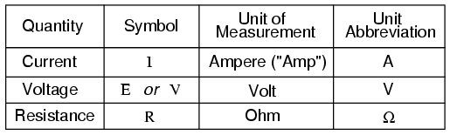
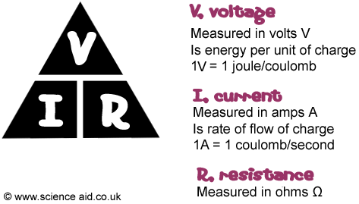
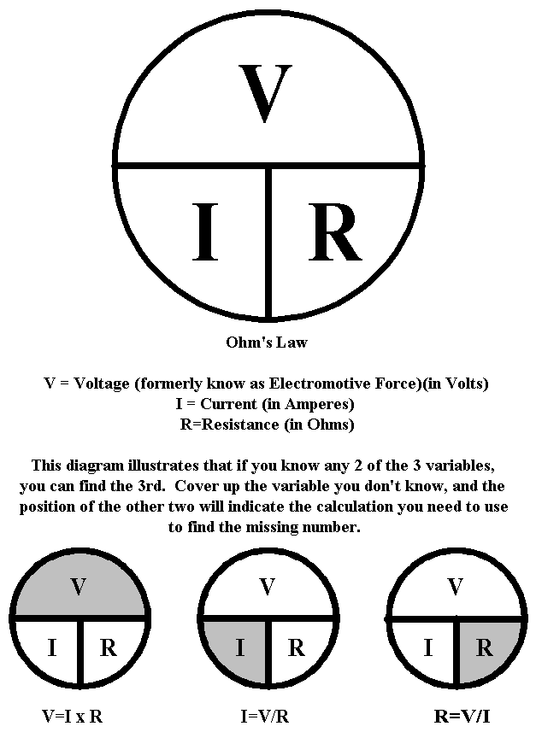

Slide 13


Basic Circuits
A circuit is a path through which electricity can flow.
Most circuits have three parts:
  An energy source
  One or more loads (run by electricity)
  Conductors (wires) that connect the two

Slide 14

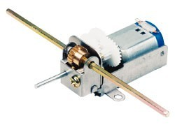
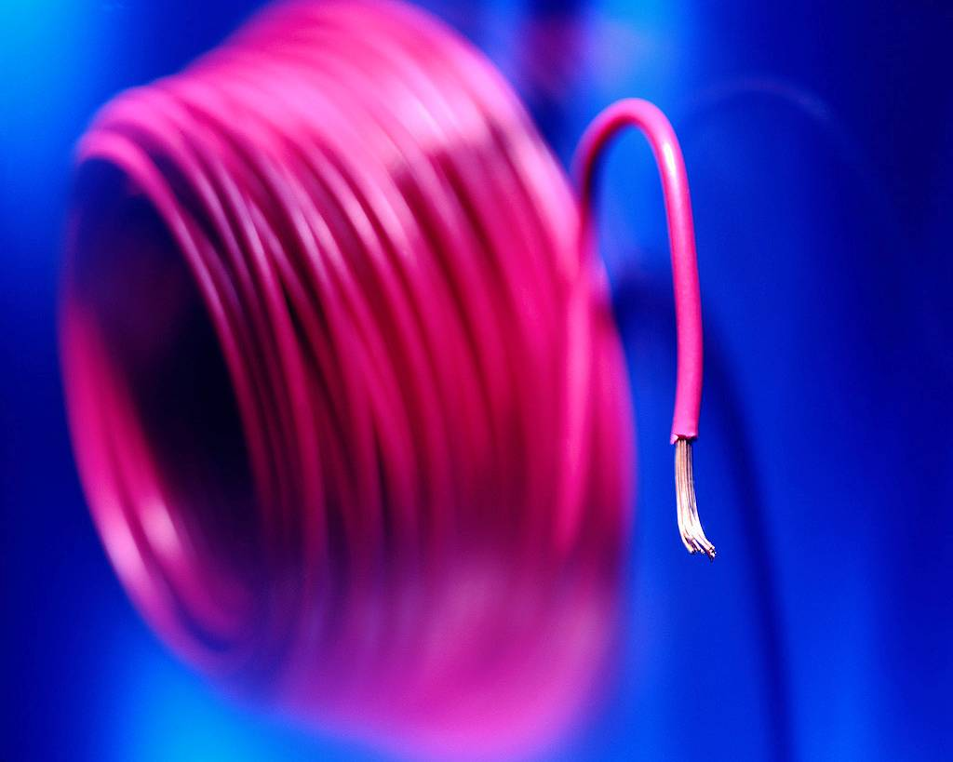
Parts of a Circuit
Energy Source – A circuit needs an energy source to push a charge through the circuit.
  Examples?
Load – a load is a device in a circuit that operates using electrical energy.
  Examples?
Conductor – a conductor is a material that allows electrical energy to flow through it easily.
  What makes a good conductor?
  Examples?

Slide 15


Parts of a Circuit Continued
Resistor – a resistor is an object added to a circuit that restricts the flow of electrical energy.
  Resistors inhibit the flow of electric current by producing a voltage drop when current passes through them. They limit current and cause some electric energy to be given off as heat.
  Examples?
Switch - a switch is a device that is used to control the flow of current through a circuit.
  A switch works by separating (open) or bringing together (closed) two conductors attached to a circuit.

Slide 16
Circuit Switches
Add a switch to your circuit. See what happens when you open and close the switch.
On your notes, draw a circuit with an open switch and a closed switch. Indicate whether the light is on or off.
When an electric current reaches an open switch, the current _________.
  This creates an __________ circuit.
When an electric current reaches a closed switch, the current _________.
  This creates a __________ circuit.
Why would you want a switch in a circuit?
stops
open
continues
closed

Slide 17
Closure
Draw your own circuit.

Slide 18
January 6th 2016 page 121
DO:
I will be able to explain how circuits are constructed as well as label the parts of a circuit.
EQ’s:
How would you construct a series and parallel circuit?
2. Why are parallel circuits more effective than series circuits?

Slide 19
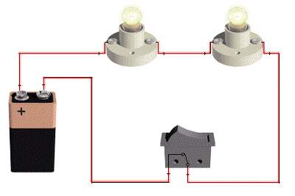
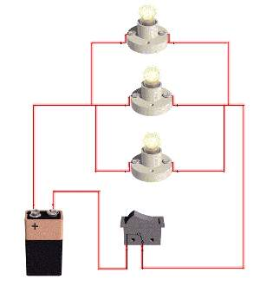
Types of Circuits
Two types of circuits:
  Series Circuit
    Provides only one possible path for the flow of current.
  Parallel Circuit
    Offers more than one path for the flow of electricity.

Slide 20
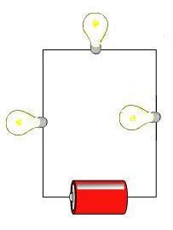
Series Circuits
In a series circuit, the loads are set up in a series, or line, that requires the current to flow through one load before passing through the next.
Create a series circuit using the materials at your table. (the switch is optional)
Draw your circuit on your notes sheet.
Use arrows to indicate the direction the electric current is traveling.

Slide 21
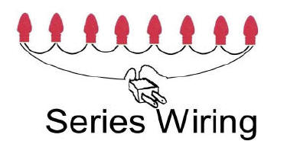

Series Circuits Continued
If you were to disconnect one of the bulbs in your circuit.
  What happens to the other bulbs?
    Because there’s only one path for the current to follow, a failure or break in any part of the switch will stop the flow of electricity through the entire circuit.
  Where have you seen this happen before?

Slide 22
Series Circuits Continued
  Because all of the loads share the same energy source. This means that the current lowers as more loads are added to the circuit.
  What if the loads were motors? Would they be able to do as much work if they’re wired in a series?
On your notes, list the disadvantages of using a series circuit.

Slide 23
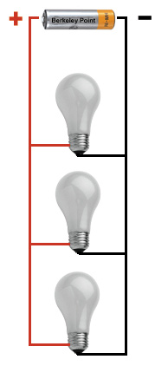
Parallel Circuits
In a parallel circuit, each load has its own path for electricity.
Create a parallel circuit using the materials at your table. (the switch is optional)
Draw your circuit on your notes sheet.
Use arrows to indicate the directions the electric current is traveling.

Slide 24
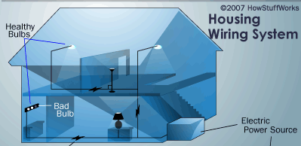
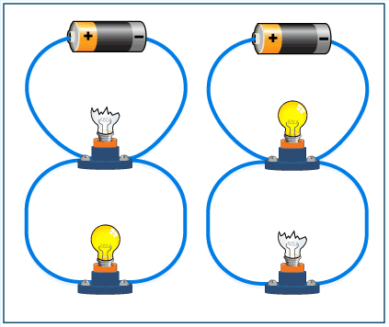
Parallel Circuits Cont.
If you were to disconnect one of the bulbs in your circuit.
What would happen to the other bulbs?
  Because a parallel circuit provides more than one path for electricity, a failure in one part of the circuit will not affect another part of the circuit.
Where have you seen this happen before?

Slide 25
Parallel Circuits Cont.
When you reconnect your parallel circuit the bulbs are still bright.
Even if all bulbs are connected or some are out the brightness is the same.
  The loads in a parallel circuit do not share current in the way that loads connected in a series will share.
  Each load connected to a parallel circuit uses the full voltage of the energy source.
  What if the loads were motors?
  Would they be able to do as much work if they’re wired in a series?

Slide 26
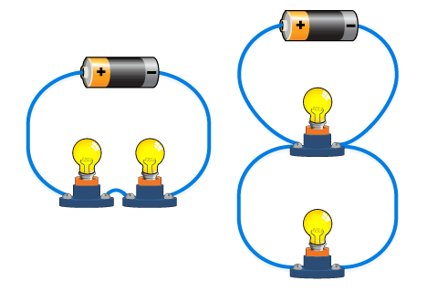
Series VS. Parallel
Which would cause the energy source (battery) to be drained more quickly?
Which uses more electric energy?
What’s the big deal?
  What happened when you added more loads to a series circuit vs a parallel?
  Why don’t we use Parallel circuits all the time?

Slide 27
January 8th 2016 page123
DO:
I will be able to explain what forms electricity, as well as construct & diagram circuits that harness electricity, and compare and contrast the advantages and disadvantages of each type.
EQ’s:
Diagram a parallel and series circuit. Include a load, source, and path for each)
Compare and Contrast series and parallel circuits.
Explain the technical issues that could arise and cause an incomplete path.
Explain how circuits can be used to express the law of conservation of energy.

Slide 28
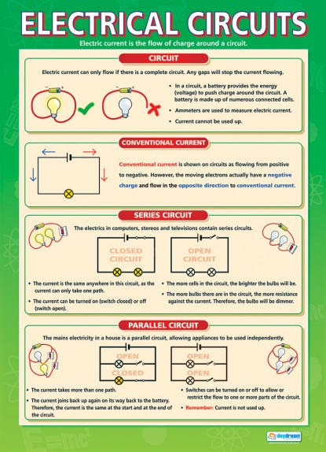
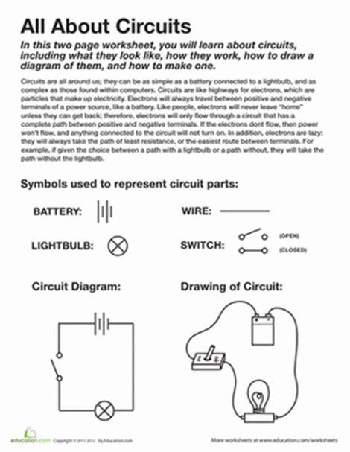

Slide 29
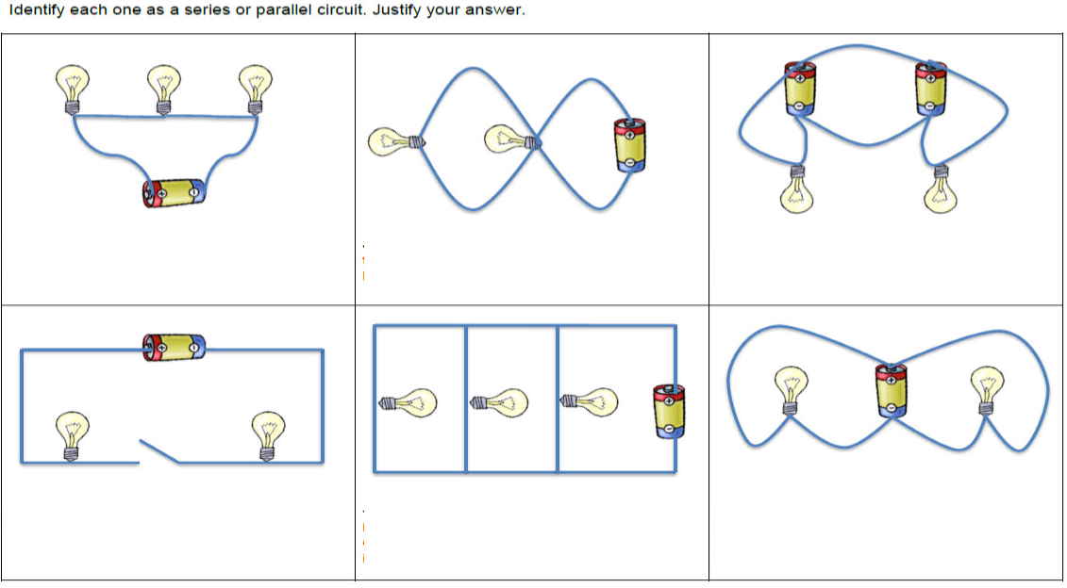
Is it a Series Circuit or Parallel Circuit?

Slide 30
January 11th 2016 page123
ASNSWER THE EQ’s:
Diagram a parallel and series circuit. Include a load, source, and path for each)
Compare and Contrast series and parallel circuits.
Explain the technical issues that could arise and cause an incomplete path.
Explain how circuits can be used to express the law of conservation of energy.

Slide 31
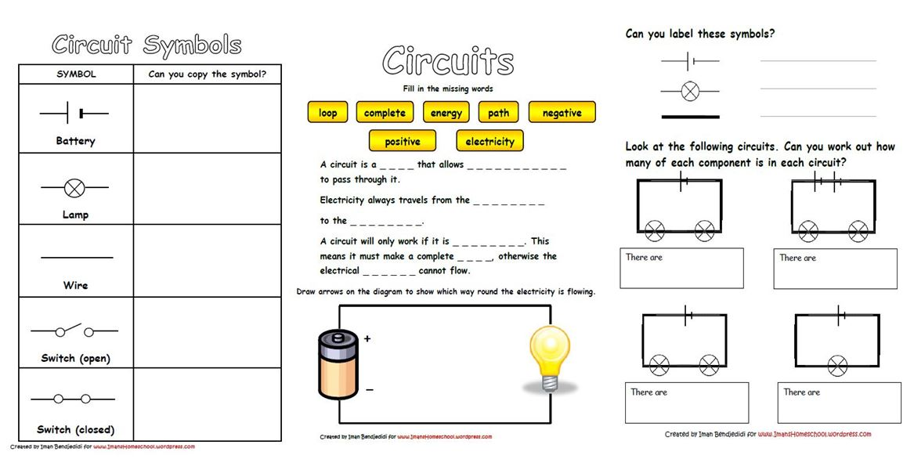

Slide 32
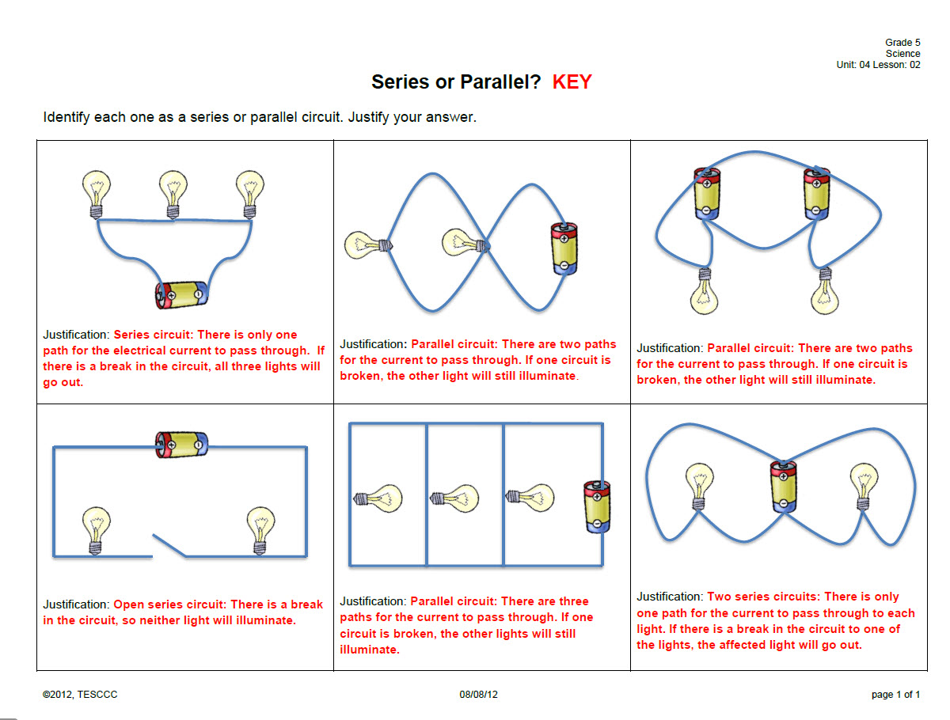
Is it a Series Circuit or Parallel Circuit?

Slide 33
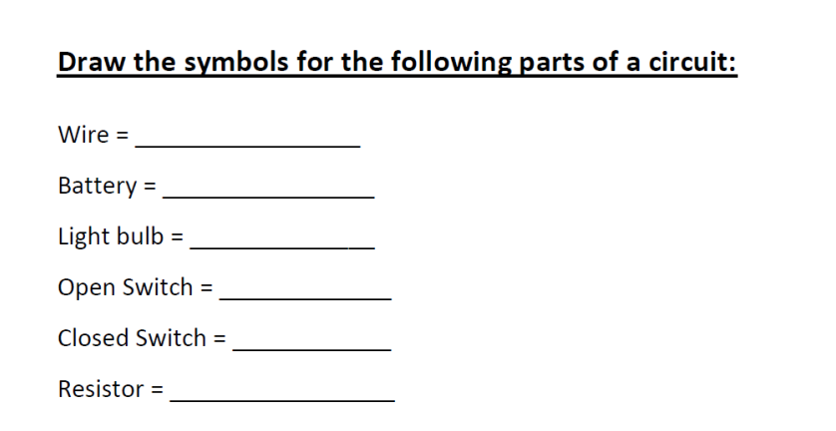

Slide 34
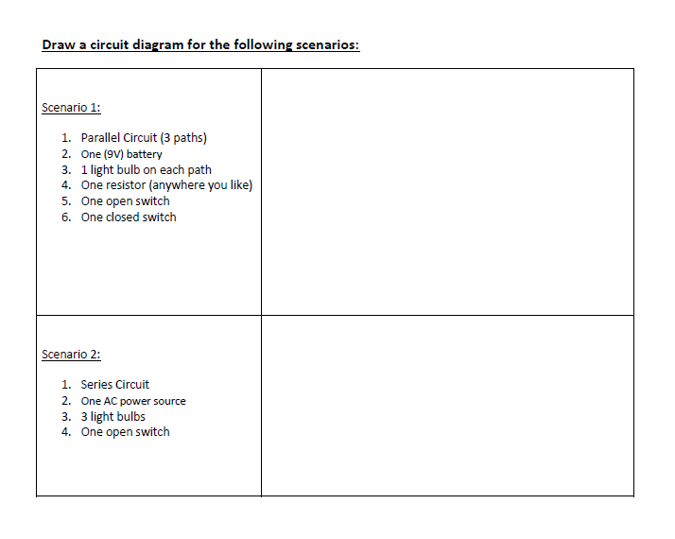

Slide 35
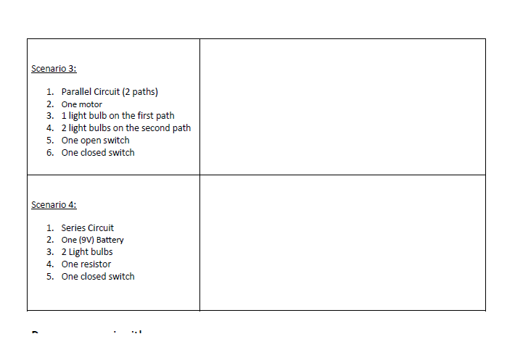

Slide 36
Work Time
MIDTERM CORRECTIONS
OR
Finish working on the section 4 and 5 Reviews in Chapter 20 of the textbook. (page 706-717)
OR
Tesla/Edison Investigation

Slide 37
Closure
3- Things that I could teach
2- Questions for a test
1- A song, show, movie that connects is…

Slide 38
Don’t forget to visit Brain POP!!
https://www.brainpop.com/technology/energytechnology/electriccircuits/
https://www.brainpop.com/technology/energytechnology/currentelectricity/

