Slide 1
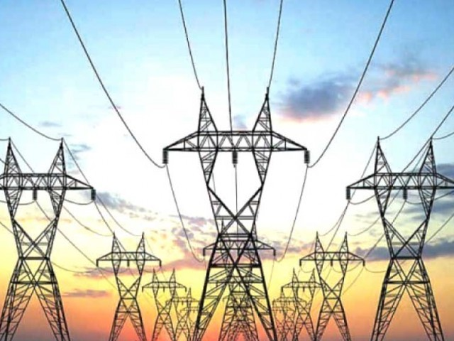
Chapter 9: Energy Resources

Slide 2
Energy Conservation
is the practice of using less energy.
Examples:
http://study.com/academy/lesson/energy-conservation-and-energy-efficiency-examples-and-differences.html

Slide 3
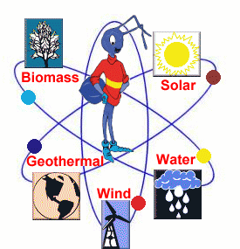
Renewable Sources of Energy
resources that are always there, never run out, and renew themselves easily

Slide 4
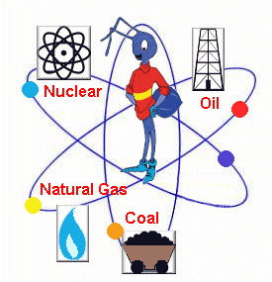
Nonrenewable Sources of Energy
resources that can be used up and cannot be reproduced

Slide 5
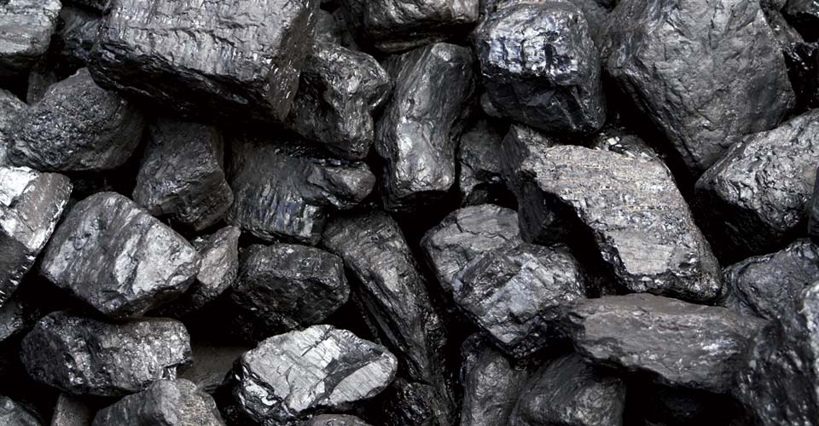
Coal- Advantage
Easy to transport (move from place to place), burns easily, and cheap

Slide 6
Coal- Disadvantages
Pollutes the air, adds to greenhouse effect due to excessive CO2, Nonrenewable

Slide 7
Coal- Miscellaneous
Solid fossil fuel made from the remains of dead swamp plants; factories use coal

Slide 8
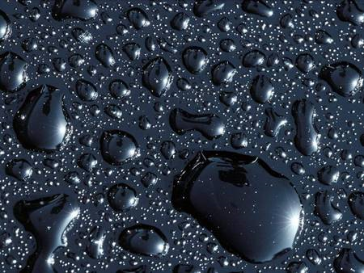
Oil- Advantage
Produces large amounts of energy, one of the most abundant, easy to transport

Slide 9
Oil- Disadvantages
Pollutes the air, water, and ground! adds to greenhouse effect due to excessive CO2, Nonrenewable

Slide 10
Oil- Miscellaneous
U.S. uses about 1/3 of ALL oil produced in the world, but we only have 3% of Earth’s oil supply in our country: gas for cars comes from refined oil

Slide 11
Solar- Advantages
Pollution free, low maintenance cost, noise free, rebates from the government, renewable

Slide 12
Solar- Disadvantages
Requires sunshine (doesn’t work @ night!) Expensive solar panels

Slide 13
Solar- Miscellaneous
Heats up the inside of cars in parking lots – this is called passive heating: provides electricity

Slide 14
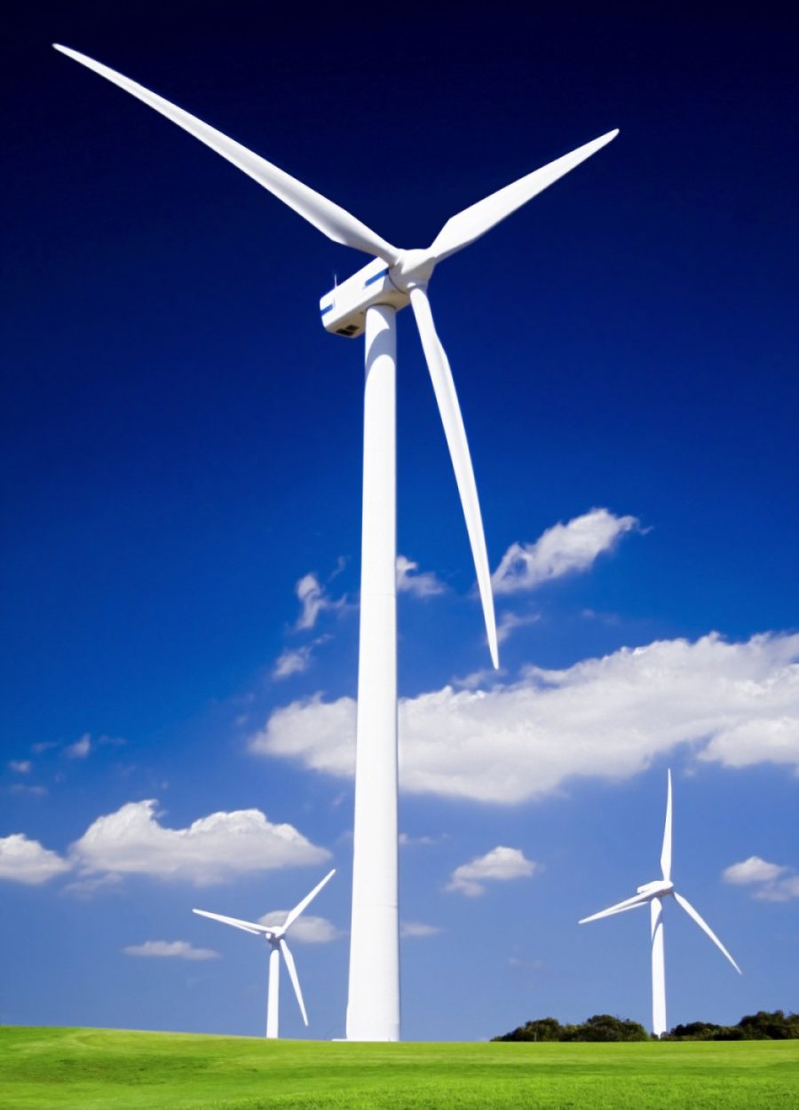
Wind- Advantages
Renewable
No pollution
Cheap once built
Energy can be stored
Large amounts of energy produced

Slide 15
Wind- Disadvantages
Requires strong and steady winds
Uses noisy generators
Can kill birds
Cast shadows on the land

Slide 16
Wind- Miscellaneous
Fastest-growing energy source in the WORLD; electricity

Slide 17
Hydroelectric- Advantages
Renewable, No pollution, controls the risks of floods, provides water areas that could otherwise be without.

Slide 18
Hydroelectric- Advantages
Renewable, No pollution, controls the risks of floods, provides water areas that could otherwise be without.

Slide 19
Hydroelectric- disadvantages
Dams cause harm to the natural environments, requires HUGE flowing water source. Stop the natural flow of water!

Slide 20
Hydroelectric- Miscellaneous
Most widely-used renewable resource: electricity for homes/buildings

Slide 21
Geothermal- Advantages
Renewable, No pollution, enormous amounts of stored energy! simple and safe
{Watch Youtube: Geothermal Thermal Heating (1:17) animated}
https://www.youtube.com/watch?v=lWOa5E2cDHY

Slide 22
Geothermal- Disadvantages
Limited availability (it’s not easy to get to)
Deep drilling is EXPENSIVE!

Slide 23
Geothermal- Miscellaneous
In Iceland, most homes are heated with geothermal energy.
{Watch Youtube: Geothermal Energy in Iceland (6:42)}
https://www.youtube.com/watch?v=XRAQrDduaU0

Slide 24
Nuclear- Advantages
Produces huge amounts of energy! Brings jobs to a country, cause little pollution
Plant Vogtle, located in Waynesboro, Ga., contains the first new nuclear units in the US in 30 years.

Slide 25
Nuclear- Disadvantages
Nonrenewable, Produces radioactive wastes (toxic when something goes wrong!)
Plant Vogtle, located in Waynesboro, Ga., contains the first new nuclear units in the US in 30 years.

Slide 26
Nuclear- Miscellaneous
reactor meltdowns can cause environmental harm & dangers
Plant Vogtle, located in Waynesboro, Ga., contains the first new nuclear units in the US in 30 years.

Slide 27
Biomass- Advantages
Renewable, carbon neutral
Can be made into other fuels

Slide 28
Biomass- Disadvantages
Produces methane gas when it decomposes (this gas traps heat in earth’s atmosphere)

Slide 29
Biomass- Miscellaneous
Can be made from wood, sugar cane, corn, and other crops & garbage ; fuels cars

Slide 30
Hydrogen- Advantages
Renewable
Burn cleanly
No pollution

Slide 31
Hydrogen- Disadvantages
Takes more energy to burn the hydrogen than it will produce when its burned; inefficient

Slide 32
Hydrogen- Miscellaneous
Possible new method to possibly fuel cars

