Slide 1
Economics Unit

Slide 2
Goods/Services --Pre-historic
Corn or maze
Gourds
Green beans
Squash
Sunflowers

Slide 3
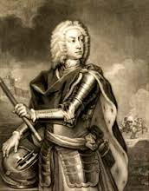
Goods/Services Colonial Times
W- WINE
R-RICE
I-INDIGO
S-SILK
T-TIMBER & TOBACCO

Slide 4
Goods/Services --Antebellum Period 1790-1860
Cotton
Wheat
Indigo
Railroads
Discovered Gold

Slide 5
Goods/ Services --Civil War 1861-1877
Cotton
Textiles
Weapons

Slide 6
Goods and Services --New South 1877-1918
Cotton
Naval Stores (turpentine, rosin, tar, & pitch)
Companies:
Coca-Cola
Atlanta Life Insurance Company

Slide 7
Goods/Services--Depression Era 1919-1940
Huff Daland Crop Dusting
Georgia Hardwood Lumber Company
agriculture changes
http://www.gpb.org/georgiastories/stories/agriculture_and_technology

Slide 8
Goods/Services --WWII Years 1941-1945
Liberty Ships- Savannah
B-29 Bombers (Super fortress)Marietta
Military training facilities

Slide 9
Goods/Services --Post War Years 1945-Present
Pecans
Peanuts
Peaches
Vidalia Onions
Shrimp
Cattle
Poultry
Granite
Many businesses/industries

Slide 10
SERVICE INDUSTRIES
THOSE INVOLVED IN PERFORMING ACTIONS
FOOD AND BEVERAGE
CARPET
MEDICAL CARE
BANKING
INSURANCE
HAIR CUTTING
CAR REPAIR
EDUCATION

Slide 11
TRADE
VOLUNTARY EXCHANGE OF GOODS AND SERVICES AMONG PEOPLE AND COUNTRIES
PREHISTORIC DAYS-PRESENT
BARTERING- THE TRADING OF GOODS AND SERVICES WITHOUT THE USE OF MONEY- INITIAL ECONOMIC SYSTEM IN THE “New World” (Explores/Native Americans)
MERCANTILISM- ENGLAND’S TRADE POLICY THAT IT SHOULD EXPORT MORE THAN IT IMPORTS

Slide 12
TRANSPORTATION IMPACTS THE ECOMONY
DURING THE LATE 1700S AND EARLY 1800S TRANSPORTATION IMPROVED-
CANALS
RAILROADS
Farmers got goods to market faster
Georgia had few factories & imported many manufactured goods

Slide 13
4 Main Transportation Systems
Interstate Highway
Hartsfield – Jackson International Airport
Deepwater Ports (Savannah / Brunswick)
Railroads
http://www.gpb.org/georgiastories/stories/railroads_and_the_new_georgia

Slide 14
PROFIT, RISK, & ENTREPRENEURS

Slide 15
ECONOMY
THE SYSTEM OF GROWING, MAKING, SELLING, BUYING, AND USING GOODS AND SERVICES.
IN OUR MARKET ECONOMY, PRODUCERS AND CONSUMERS DETERMINE WHAT PRODUCTS ARE PRODUCED AND WHAT PRICES ARE PAID FOR THOSE PRODUCTS.

Slide 16
ENTREPRENEURS
A person who takes on the risk and organizes a business.
THEY ARE CREATIVE, INNOVATIVE THINKERS, AND ARE RISK TAKERS
They hope to earn a profit: the amount left after all production costs have been subtracted
Benefits:
Be Your Own Boss
Receive Majority of the Profits
Pitfalls:
50% fail in the first 5 years
Lose your own money
http://www.gpb.org/georgiastories/stories/ten_billion_questions

Slide 17
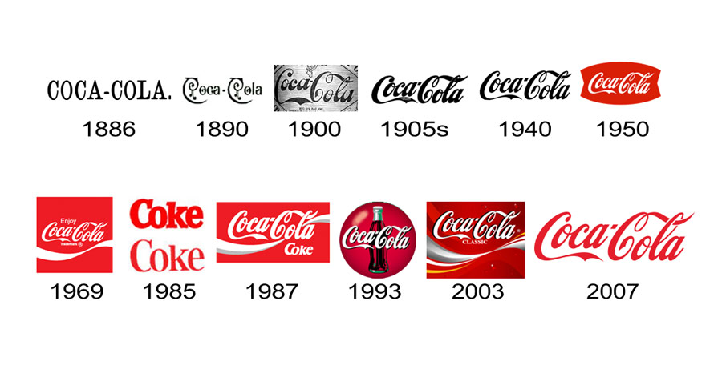
COCA-COLA
DRUGGIST- JOHN PEMBERTON-”FRENCH WINE COCA”- A SYRUP THAT INCLUDED A LARGE AMOUNT OF ALCOHOL
TEMPERANCE MOVEMENT (ANTI-ALCOHOL) CAUSED HIM TO REMOVE ALCOHOL FROM HIS TONIC SYRUP, BUT IT STILL NEEDED TO TASTE GOOD.
RENAMED TONIC-”COCA-COLA” AFTER ITS 2 MAIN INGREDIENTS: the coca plant and the kola nut
Put into pint bottles and sold for 25¢

Slide 18
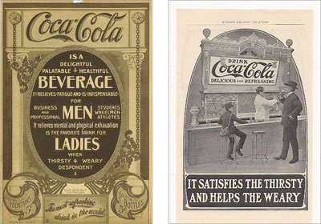
Soda jerk, Willis Venable, customer wanted headache tonic; Venable mixed syrup with soda water- customer loved it!
Asa Candler bought all stock/ $2300.
1892-drink very popular Candler made Coke a recognizable brand-formed Coca-Cola Company
1919-Candler sold company to Ernest Woodruff for $25 million
Woodruff started international advertising campaign/built bottling plants in Europe during WWII
http://www.gpb.org/georgiastories/stories/coca-cola

Slide 19
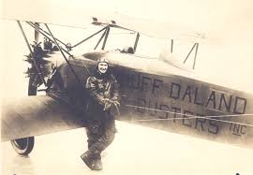
DELTA AIRLINES
1924- HUFF DALAND DUSTERS
MACON
FIRST COMMERCIAL CROP-DUSTING COMPANY
(TARGET-BOLL WEEVIL)
SOLD IN 1928 TO BUSINESSMEN IN MONROE, LOUISIANA
RENAMED-DELTA AIR SERVICE

Slide 20
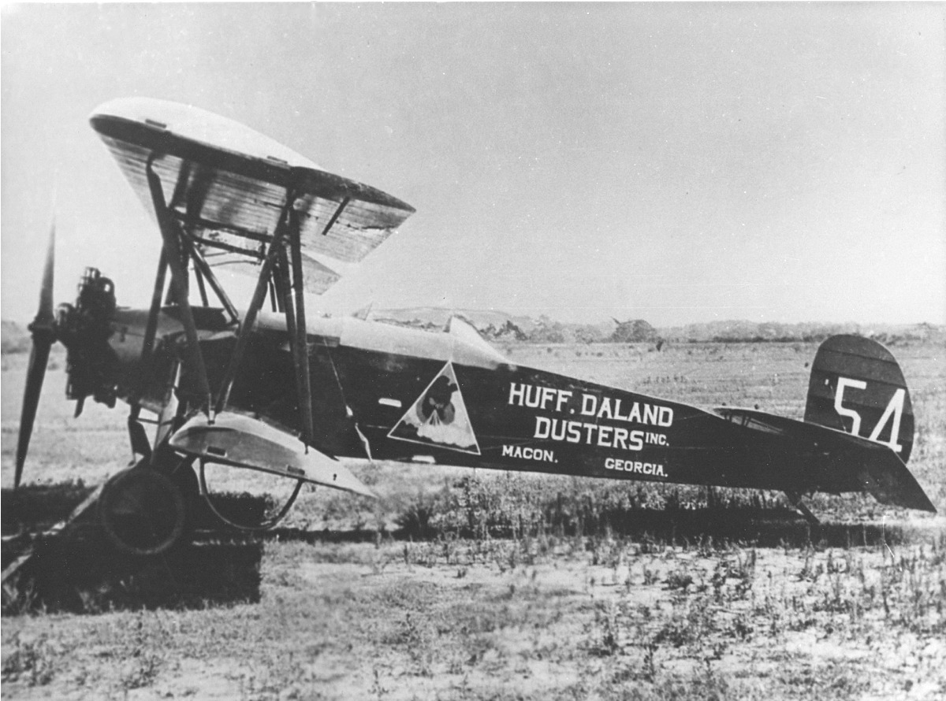
DELTA
CONTINUED CROP DUSTING UNTIL 1966
1929- BOUGHT 5 PASSENGER PLANES
1934-AIRMAIL CONTRACT BROUGHT DELTA TO ATLANTA
WWII-
TRAINED ARMY PILOTS AND MECHANICS
MODIFIED AIRCRAFT FOR USE BY MILITARY

Slide 21
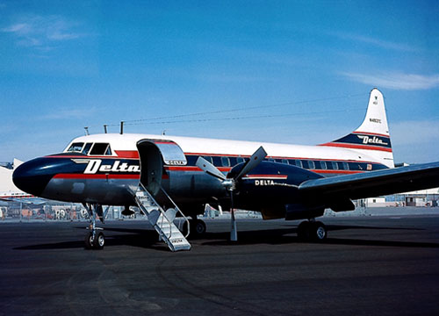
DELTA
1953- MERGED WITH CHICAGO AND SOUTHERN AIRLINES
1972- MERGED WITH NORTHEAST AIRLINES
1987-MERGED WITH WESTERN AIRLINES

Slide 22
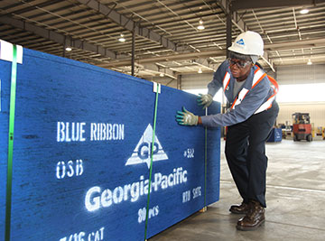
GEORGIA - PACIFIC
1927-OWEN CHEATHAM FOUNDED GEORGIA HARDWOOD LUMBER COMPANY IN AUGUSTA
WHOLESALER OF HARDWOOD LUMBER (a business that sells to other businesses)
TODAY- LEADING MANUFACTURES AND MARKETERS OF:
TISSUE
PULP
PAPER
PACKAGING
BUILDING PRODUCTS
CHEMICALS
(BRAWNY PAPER TOWELS, DIXIE CUPS & PLATES, QUILTED NORTHERN toilet paper)

Slide 23
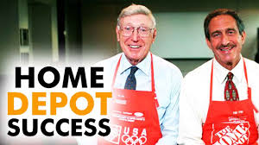
HOME DEPOT
JUNE 22,1979- FIRST STORE IN ATLANTA
BERNIE MARCUS
ARTHUR BLANK
BEGAN AS WAREHOUSE STORES FILLED WITH WIDE ASSORTMENT OF PRODUCTS AT LOWEST PRICES AND BEST CUSTOMER SERVICE

Slide 24
REVENUE & SPENDING
TAXES PAID FOR GOVERNMENT SERVICES
MOST OF GEORGIA’S REVENUE COMES FROM STATE INCOME TAX
OTHER GEORGIA REVENUE COMES FROM SALES TAX
GOVERNMENT OFFICE PREDICTS REVENUE AND ADJUSTS THE BUDGET ACCORDINGLY

Slide 25
REVENUE
REVENUE SOURCE
PERCENT OF BUDGET
PERSONAL INCOME TAX
CORPORATE INCOME TAX
SALES TAX
MOTOR FUEL TAX
OTHER TAXES
LOTTERY PROCEEDS
MISCELLANEOUS
41%
3%
29%
5%
9%
6%
7%

Slide 26
Expenditures TOP 3 ONLY
EDUCATION 54%
HUMAN SERVICES 23%
PUBLIC SAFETY 8%

Slide 27
PERSONAL FINANCE
INCOME:
THE TOTAL AMOUNT OF MONEY A PERSON MAKES IN A YEAR (GROSS)
INCOME IS DIFFERENT FROM THE AMOUNT OF “TAKE-HOME PAY” DUE TO TAXES, INSURANCE, ETC. (NET)
BILL MAKES $10 PER HOUR. SINCE HE WORKS 40 HOURS PERS WEEK, HE EXPECTED TO RECEIVE A CHECK FOR $400., BUT HIS CHECK WAS $308 INSTEAD. WHAT WAS THE REASON FOR THE CONFUSTION ON BILL’S PART?

Slide 28
SPENDING
INCOME SHOULD BE BUDGETED FOR SOMETHING THAT WILL BRING A FUTURE BENEFIT OR WILL EARN MORE MONEY
THE MOST IMPORTANT RULE IS THAT AMOUNTS FOR EXPENSES SHOULD NEVER BE MORE THAN THE AMOUNT OF INCOME
THE FIRST ITEMS IN A BUDGET SHOULD ALWAYS BE FOR NECESSARY EXPENSES

Slide 29
CREDIT
AN ARRANGEMENT BY WHICH A BUYER CAN TAKE POSSESSION OF SOMETHING NOW AND PAY FOR IT IN THE FUTURE, USUALLY WITH INTEREST
INTEREST-A PERCENTAGE PAID ON THE AMOUNT BORROWED
EXAMPLES: CREDIT CARDS, mortgages, AUTO LOANS

Slide 30
CREDIT
CREDIT VS DEBIT
CREDIT CARDS: BASED ON CREDIT REPORT USER ALLOWED TO SPEND AND PAY BACK OVER A PERIOD OF TIME
DEBIT CARDS: LOOK LIKE/USED LIKE CREDIT CARD
MONEY WITHDRAWN FROM CHECKING ACCOUNT AT THE TIME THE PURCHASE WAS MADE

Slide 31
CREDIT
CREDIT REPORTS: ISSUED BY MAJOR CREDIT BUREAUS
DETAILED HISTORY OF CREDIT WORTHINESS
THE HIGHER THE FICO SCORE=THE BETTER THE CREDIT
CREDIT SCORE: FICO SCORE REPRESENTS CREDIT WORTHINESS
HELPS LENDER IN DECISION TO LOAN MONEY

Slide 32
FICO
A FICO score is a credit score developed by FICO, a company that specializes in what’s known as “predictive analytics,” which means they take information and analyze it to predict what’s likely to happen.

Slide 33
FICO
In the case of credit scores, FICO takes credit information and uses it to create scores that help lenders predict behavior, such as how likely someone is to pay their bills on time (or not), or whether they are able to handle a larger credit line.
Scores developed by FICO can also be used to forecast which accounts are most likely to end up included in bankruptcy, or which ones are likely to be most profitable

Slide 34
SAVING
PUTTING MONEY IN A SPECIAL ACCOUNT TO EARN INTEREST
TYPES OF SAVINGS ACCOUNTS:
STANDARD SAVINGS ACCOUNT (SAFEST)
MONEY MARKET ACCOUNT
CERTIFICATE OF DEPOSIT

Slide 35
INVESTING
USING MONEY TO MAKE MONEY AND USUALLY INVOLVES A RISK-
STOCKS/BONDS/MUTUAL FUNDS
REAL ESTATE
EQUIPMENT

